Slide 1
Resolving an Internet Only Bank
Jan Geert Schouwstra
DNB - Netherlands

Slide 2
DGS practice in The Netherlands
Use of the deposit guarantee scheme (DGS) past 10 years:
Type | Year | Amount payed (in million €) | Number of clients
General bank | 2005 | 22,5 | 1.200
General bank | 2008 | 0,2 | 25
Internet bank | 2008 | 1.645 | 145.000
General bank | 2009 | 3.500 | 380.000
Notes:
This is our experience the last 30 years since the dis was introduced. The last two years we had three failures, two of them rather big so I will limit myself to the discussion of those two.

Slide 3
Internet Bank

Slide 4
Internet Bank

Slide 5
DGS for this Internet Bank (1)
Characteristics
Only one product
Only savings (with high interest)
No deficits
No mortgages, no investments, no credit cards
Payments to a bank account given in advance

Slide 6
DGS for this Internet Bank (2)
Steps/measures/actions:
Multidisciplinary steering committee
Application form
Web based application
External auditor
Hiring people
Procedures - manual
Workplace – workstations – furniture
Call center
Communication
Everything you have to do for payout

Slide 7
DGS for this Internet Bank (3)
Were we satisfied?
Yes
But ….
Some things could be better, let me explain

Slide 8
Too much paperwork

Slide 9
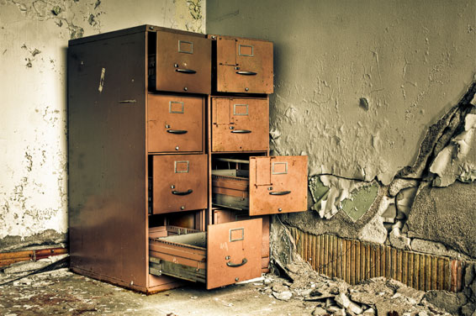
Take up on archives

Slide 10
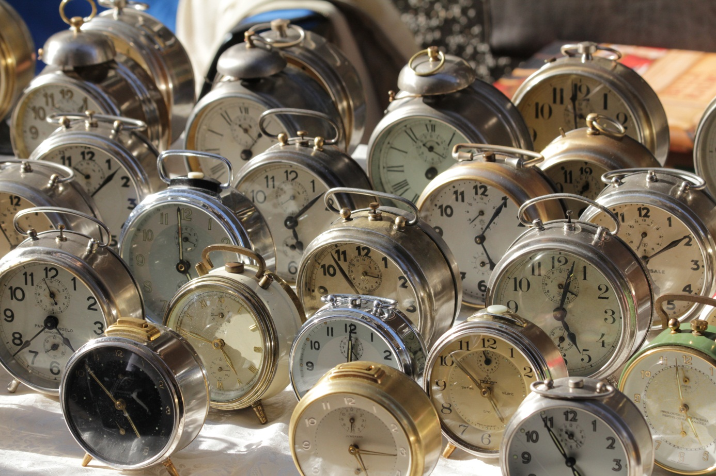
Very long throughput time

Slide 11
Complex audit

Slide 12
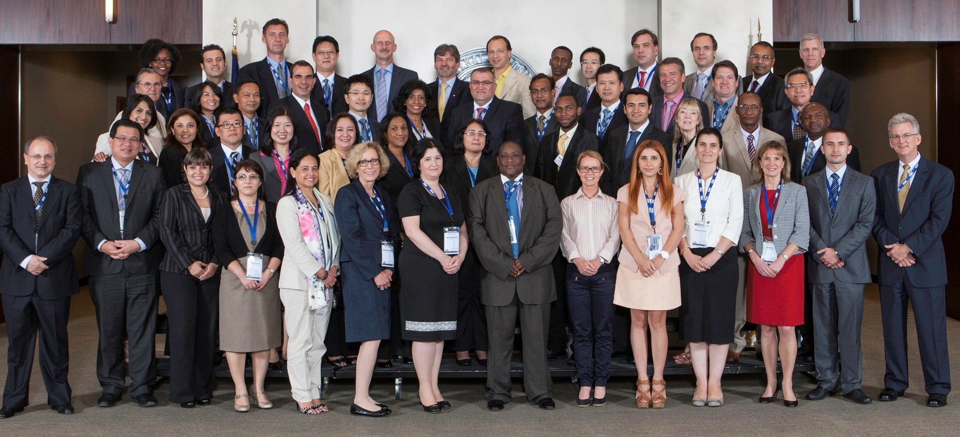
A lot and diversity of people

Slide 13
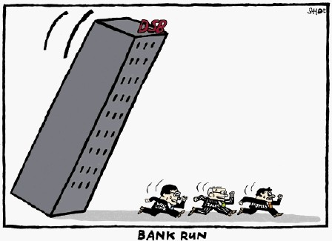
DGS for an other bank

Slide 14
future: a change is necessary
Starting point for DNB in 2010:
Payment within 20 days
NO paper
Computerized processing, judgment and payment
Banks are responsible: now!
Payment only to bank accounts
No settlement with debts
No difference between an internet bank and a normal bank

Slide 15
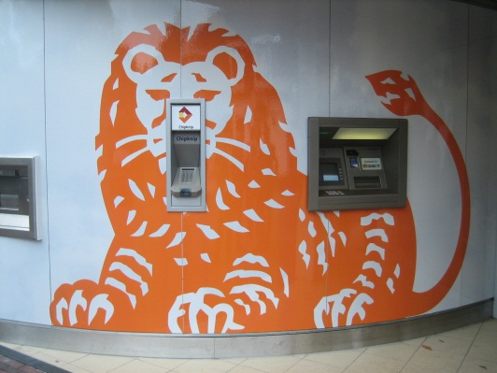
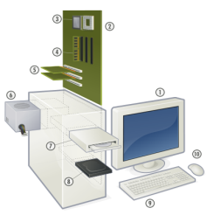
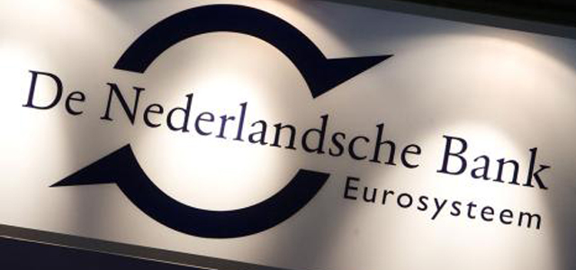
Process (simplified)
Website
data

Slide 16
What did we (DNB) do
Built a new application
Give instructions to banks for delivering a file to DNB (same format, same structure)
Periodically testing files from banks
Internal manual and procedures
Contracts with third parties
Yearly Report of Findings from auditor Bank

Slide 17
Report of Findings auditor
Is the process OK for delivering a correct and complete DGS file on time?
What are the relevant risks?
How are the risks controlled?
Control measures incorporated
Aspects: processing pipeline items; calculating interest; accrual of the balances
Existence of these control measures and do they work?
Give key data in the report.

Slide 18
Process if DGS is necessary
BANK
DNB
DEPO- SITOR
DNB

Slide 19
Process if DGS is necessary
BANK
DNB
DEPO- SITOR
DNB
Bank failure / bankruptcy
DNB activates DGS
Bank processes pipeline items
Bank calculates interest
Bank compiles the file and transmits it with an auditors opinion to DNB
Time needed: 7 days

Slide 20
Process if DGS is necessary
BANK
DNB
DEPO- SITOR
DNB
DNB loads the file in their application and will check consistency and quality criteria
DNB construct the single customers view (CSV) for each person or company
Application calculates the claim
Web portal will be loaded with CSV and the decision paper of the payout
Time needed: 6 days

Slide 21
Process if DGS is necessary
BANK
DNB
DEPO- SITOR
DNB
Digital Identity = DigiD
Use the web based application

Slide 22
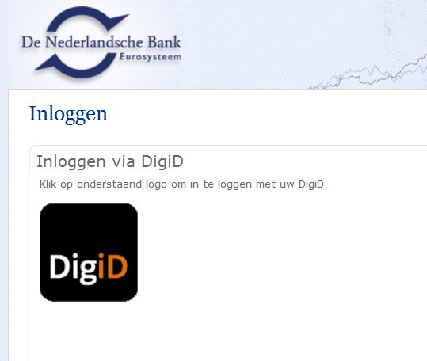
After entering www.dgs....nl you see this screen
CLICK ON

Slide 23
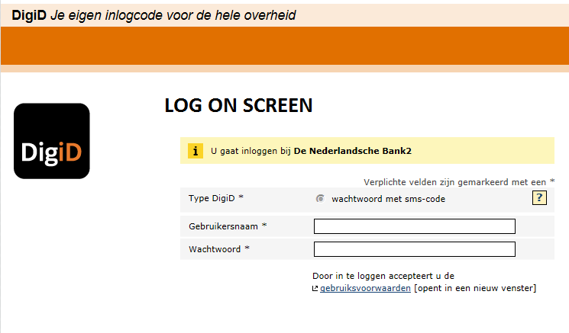
MY NAME IS JAN
MY SECRET PASSWORD
Log on

Slide 24
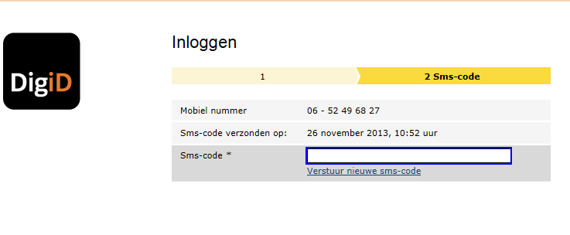
notification by text message (phone)
XHEYWTD763
next

Slide 25
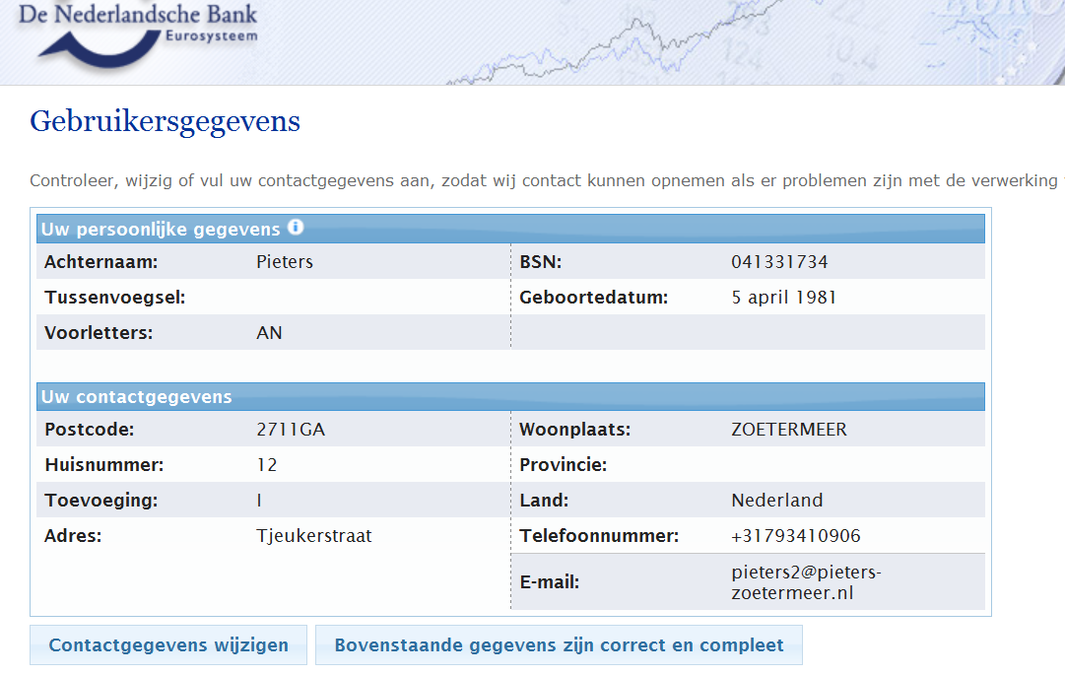
Screen with personal information; if OK next screen

Slide 26
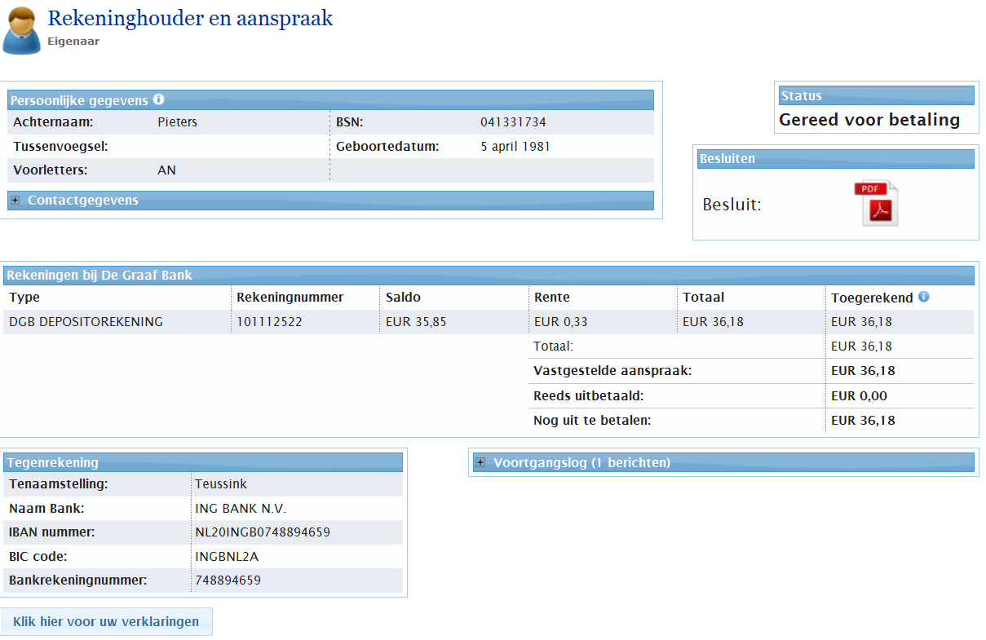
Information of claim, account and decision DNB
Ready for payment
decision

Slide 27
Process if DGS is necessary
BANK
DNB
DEPO- SITOR
DNB
DNB send the information to Equens that will pay out the amount to the depositor
Time needed: less than 1 day
DNB gives the liquidator information: the payouts

Slide 28
Activities during Peacetime
Preparations for every bank:
Follow the DNB manual
Test files
Investigation auditor
Preparations by DNB:
Web based application up to date
Assessment files and report auditor bank
Contracts

Slide 29
DNB Topics for next year
Testing files of banks
Adjust application for foreign branches
Renew manual banks
Renew manual for DNB
Renew contracts
….
….
….

Slide 31
Resolving an Internet Only Bank
Jan Geert Schouwstra
DNB - Netherlands

