Slide 1
Seamless Access To Insured Deposits
Malaysia Deposit Insurance Corporation
Shrither Nagalingam
Deputy General Manager
MALAYSIA DEPOSIT INSURANCE CORPORATION

Slide 2
Agenda
Malaysia Deposit Insurance Corporation
Section 1 |  | MDIC’s Payout framework
Section 2 |  | MDIC’s Payout System
Section 3 |  | Seamless Payout
Seamless Access To Insured Deposits

Slide 3
Malaysia Deposit Insurance Corporation
1
Section
Introduction
Seamless Access To Insured Deposits

Slide 4
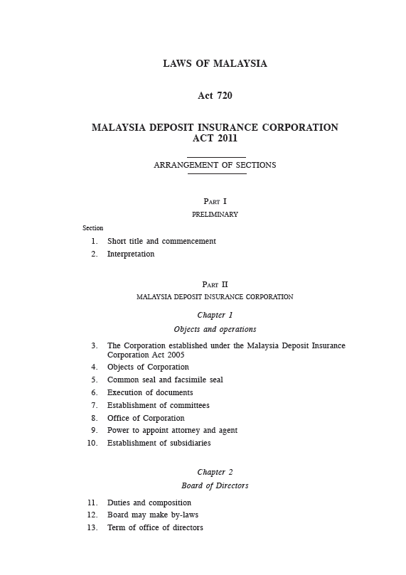
Malaysia Deposit Insurance Corporation
Preamble to the Malaysia Deposit Insurance Corporation Act 2011, amongst others, states….
Where as the stability of the financial system is a key determinant of the economic growth and prosperity of Malaysia:
And Whereas the deposit insurance system and the takaful and insurance benefits protection system are important components of the financial safety net since they promote and contribute to the stability of the financial system:
And Whereas the purpose of the deposit insurance system and the takaful and insurance benefits protection system is to protect depositors from the loss of part or all of their deposits and takaful beneficiaries and insured persons from the loss of part or all of their takaful or insurance benefits in the event of the failure of a member institution and the Malaysia Deposit Insurance Corporation is to carry out its mandated functions with speed and efficiency and promote sound risk management in the financial system and promote and enhance financial consumer protection:
And Whereas special provisions are required in the public interest to empower the Corporation to implement promptly the resolution actions set out in this Act at minimum cost to the financial system.
Seamless Access To Insured Deposits

Slide 5
MDIC’s approach to reimbursement of deposits
Malaysia Deposit Insurance Corporation
Effective Payout
Traditional Payout
Seamless Access To Insured Deposits

Slide 6
Malaysia Deposit Insurance Corporation
MDIC’s approach to reimbursement of deposits
1
Legislated subrogation of depositors rights and interests
Structural
2
Simple coverage rules- no right of set off, no de-aggregation of joint accounts information
3
No requirements to file claims, convenience to the depositors.
4
Access to depositors’ information on an on- going basis in a standard file format
Seamless Access To Insured Deposits

Slide 7
MDIC’s approach to reimbursement of deposits
Malaysia Deposit Insurance Corporation
1
Set Data Cleansing and Submission Standards – interest computation, reconciliation etc
Strategies and rules
2
Upfront determination of product insurability status
3
Validation of Total Insured Deposits and trial runs to ensure MI’s readiness to provide clean, accurate and complete information.
Seamless Access To Insured Deposits

Slide 8
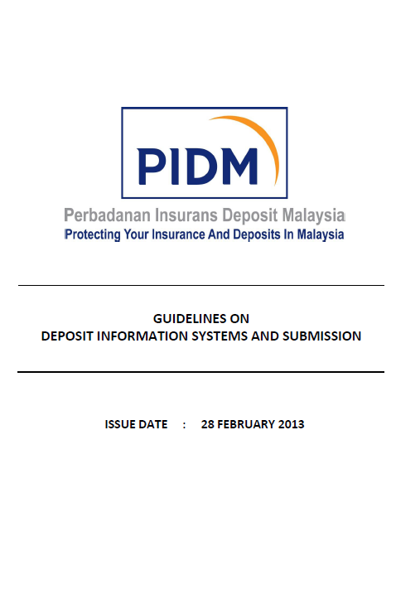
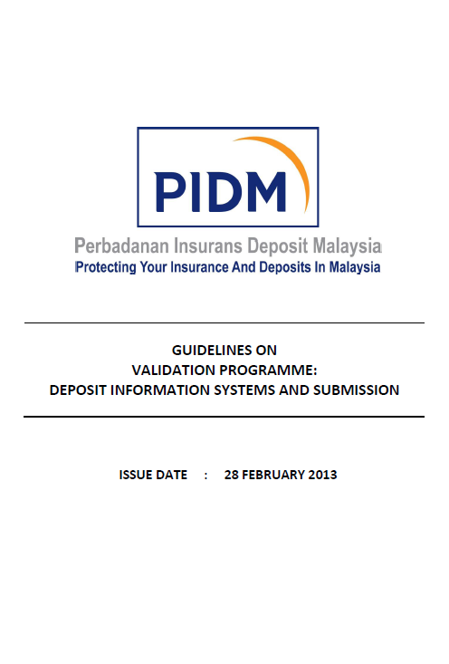
Malaysia Deposit Insurance Corporation
DTMs readiness to provide accurate and reliable deposit information is critical to the Payout framework
Members are required to submit the deposit information in SFF based on 31 December each year by 31 May of the following year.
New
Revised
Guidelines on Deposit Information System and Submission
Contains guidelines on submission of deposit data and minimum requirements of a deposit liability system
Revisions include :
Annual compliance certification requirement
Reconciliation of deposit balance in SFF to general ledger requirement and sample template
Administrative requirements (eg use of submission checklist, appointment of SFF Liaison Officer etc)
Guidelines on Validation Programme : Deposit Information System and Submission
Sets out overview of validation programme and external auditor validation procedures for implementation with effect 2013. First year submission to be made by May 2013.
Seamless Access To Insured Deposits

Slide 9
Malaysia Deposit Insurance Corporation
DTMs readiness to provide accurate and reliable deposit information is critical to the Payout framework
Nine (9) minimum requirements for deposit liability system
(i) | DTMs shall maintain unique Customer Information File (CIF)numbers for each depositor
(ii) | DTMs shall ensure that their sub-ledger and general ledger deposit balances are reconciled at all times
(iii) | DTMs’ deposit system shall be able to identify the insurability status of all deposit products
(iv) | DTMs shall register all deposit products with the Corporation
(v) | DTMs’ deposit systems shall be able to identify each deposit by depositor type in line with the separate insurance coverage provided to each depositor type
(vi) | DTMs’ deposit system shall be able to compute interest or returns for each account on a daily basis
(vii) | DTMs’ deposit system shall have the capability of maintaining beneficiary information for trust account
(viii) | DTMs’ deposit and remittance systems shall be able to identify and track whether remittances and bills payable instruments (such as cashier orders, interbank GIRO, internet banking, telegraphic transfers) are made through cash payments or by debiting of deposit accounts
(ix) | DTMs’ deposit system shall be able to track the clearing status of the cheques deposited to the deposit accounts
Seamless Access To Insured Deposits

Slide 10
Malaysia Deposit Insurance Corporation
2
MDIC’S
PAYOUT SYSTEM
Section
Seamless Access To Insured Deposits

Slide 11
Malaysia Deposit Insurance Corporation
Our Payout Readiness Journey
System Development
Guidelines
Trial runs
Rating
Monitoring
Seamless Payout
2008 | 2009 | 2010 | 2011 | 2012 | 2013 | 2014 | 2015 | 2016
Embarked on project to develop Payout System
Conducted trial run with DTMs to ensure compliance to SFF requirements
Commenced development of seamless payout capabilities.
Issued DISS Guidelines which sets out SFF requirements & 9 minimum requirements for deposit liability system
Ability to classify DTMs that are payout ready
Implement framework to ascertain if information provided in SFF is accurate and reliable.
Seamless Access To Insured Deposits

Slide 12
There are 5 performance objectives with emphasis being accorded to Quality and Speed
Malaysia Deposit Insurance Corporation
Our Payout Strategy
Speed
Timely Payout
Reliability
Consistent performance among payouts
Quality
Accurate Payout
Flexibility
Adaptability to new processes or products
Cost
Amount incurred to effect payout
Seamless Access To Insured Deposits

Slide 13
Our Payout System
MI
Depositors Support Management System (DSMS)
Depositors Liability Information Management System (DLIMS)
Depositor details
Data in SFF
View Depositors details account
Update Depositors information
Depositors information request
Process Depositor’s Data
Reconciliation
Aggregation
Generate Payment List
Update Info
Product Registry System (PRS)
List of account
Deposit Code
Insurability status
Payment list
Payment status update
FWD Request
Info & request
Request
status
Payment
Agent
Payment
and statement information
Payout Payment Management System (PPMS)
Request Management System (RMS)
Bank transfer
Failed ATMs
Cheques
Generate Payment Statements
Fwd Request
Process payment
Receivable List
Payment status
Accounting System
Investigation
Approval
Payment status update
Request
status

Slide 14
Malaysia Deposit Insurance Corporation
Video Walkthrough on Payout System
Seamless Access To Insured Deposits

Slide 15
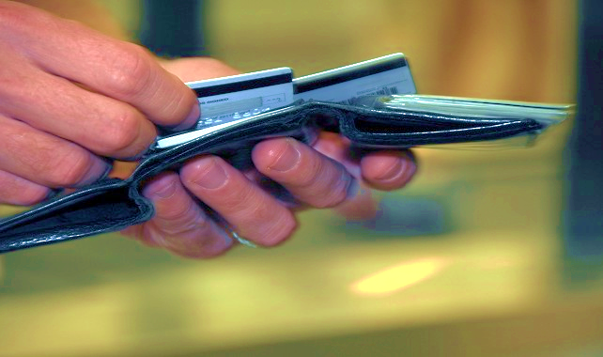
Malaysia Deposit Insurance Corporation
3
Section
SEAMLESS PAYOUT
Seamless Access To Insured Deposits

Slide 16
Our Payout Vision
Malaysia Deposit Insurance Corporation
Access to funds at all time
ATM cardholders will be allowed to make
withdrawals / transfer of balances of insured deposits to another bank through ATMs
A seamless payout
Depositors can transfer funds to another bank through internet banking.
Depositors will be able to go to any bank to withdraw funds and/or open a new
deposit account.
Seamless Access To Insured Deposits

Slide 17
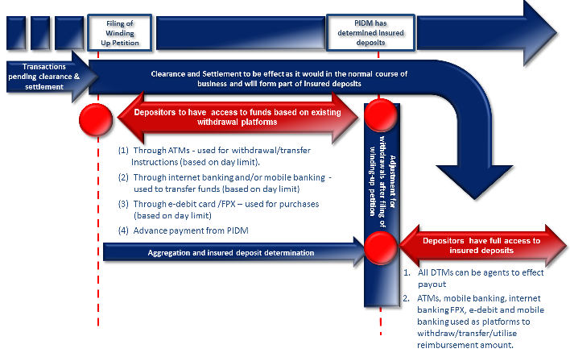
Malaysia Deposit Insurance Corporation
There are three (3) main aspects to the seamless payout proposal
1
Inflows - Bank draft, cheque or other similar instrument or instruction deposited into the account by depositors will be credited to the depositors account subject to availability of funds in the payor’s account.
Outflow - cheques issued by depositor which are presented for clearing & IBG transfers made prior to closure will be effected in the normal course*.
2
Depositors will continue to be allowed to use all modes of withdrawal (eg. ATMs. Transfers via Internet Banking platform, Mobile banking, E-Debit, FPX)
Depositors will have multiple avenues to withdraw the insured deposits
3
* PIDM has the opportunity on T2 to disallow clearance of these cheques and IBG transactions, if it so wishes.
Seamless Access To Insured Deposits

Slide 18
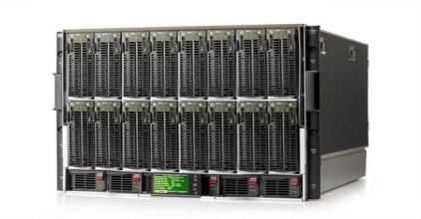
Malaysia Deposit Insurance Corporation
Under Development
MDIC’s Payment list would be accessible at multiple points
Secure Server
Connected through secure line
Depositor Access Points
Branch 1B
Deposit Balance verification
Branch 1A
Bank 1
Payment File & updates
Replicate Data
Branch 2B
Branch 2A
Bank 2
ATM Network
MDIC ‘s Payout System
Authentication of depositor using existing MI infrastructure
Standard File
Format
Internet Banking
Failed Bank
Seamless Access To Insured Deposits

Slide 19
Malaysia Deposit Insurance Corporation
Co-operation between the various agencies are required
Requires a joint effort between MDIC, the operator of centralized clearing house and national payment system operator, the switching provider for ATM, the Central Bank and all banks participating as payment agent.
Payment system operator
MDIC
ATM Operator
Central Bank
Payment Agent Banks
Seamless Access To Insured Deposits

Slide 20
Malaysia Deposit Insurance Corporation
Thank You
Seamless Access To Insured Deposits

