Slide 1
CDIC Taiwan’s Solution to Address Poor Data Quality
Ying-Ying Lin
Deputy Director
2 December, 2013

Slide 2
Outline
Introduction of CDIC (Taiwan)
Establishment of the E-data Files
Inspection of the E-data Files
Challenges and Conclusion

Slide 3
1. Introduction of CDIC (Taiwan)

Slide 4
Introduction of CDIC (Taiwan)
Establishment in 1985 28 years
The only deposit insurer in Taiwan
Public policy objectives
Safeguard the interests of depositors in financial institutions
Maintain an orderly credit system
Enhance sound development of financial businesses

Slide 5

Mandate
Introduction of CDIC (Taiwan)
Handle deposit insurance issues
Control insurance risk
Deal with problem financial institutions
Pay Box
Risk Minimizer

Slide 6
Number of Insured Institutions
Introduction of CDIC (Taiwan)
As at Oct 31, 2013
Types of insured institutions | No. | No. of branches
Domestic banks | 39 | 3,437
Local branches of foreign banks | 29 | 37
Credit cooperatives | 24 | 257
The postal savings system | 1 | 1,322
Credit dept. of farmers’ associations | 277 | 819
Credit dept. of fishermen’s associations | 25 | 44
Total | 395 | 5,916

Slide 7
Insured & Uninsured Deposits
Introduction of CDIC (Taiwan)
Coverage amount
NT$ 1.5 million
(about US$50,000)
NT$ 3 million
(about US$100,000)
Insured Deposits | Uninsured Deposits
Checking deposits Demand deposits Time deposits Deposits required by law to be deposited in certain financial institutions Other deposits approved as insurable by the Financial Supervisory Commission | Negotiable certificates of deposit Deposits from government agencies Deposits from the Central Bank Deposits from banks, postal savings bank, credit cooperatives, and farmers' and fishermen's associations with credit departments Other deposits which the Financial Supervisory Commission has approved as non-insurable 6. Deposits exceeding the per-institution maximum insurance coverage established for each depositor
CDIC covers insured deposits of natural & legal persons both in local and foreign currencies.

Slide 8
Depositors
Introduction of CDIC (Taiwan)
Each depositor
1. Natural person
2. Legal entity
3. Sole proprietorship
4. Partnership
5. Inheritee
6. Bankruptcy or liquidation estate
7. Unincorporated group or organization
8. Various levels of government or their subsidiaries
9. Trust estate
10. Cardholder for each electronic stored value card

Slide 9
Fulfillment of Insurance Responsibilities
Introduction of CDIC (Taiwan)
Payout
Cash payout
Deposit transfer
P&A
Other responsibilities
Legal receiver (advance dividend)

Slide 10
2. Establishment of
the E-data Files

Slide 11
Establishment of the E-data Files
Promptly Reimbursement
By DI act
When an insured institutions is closed by the competent authority, and the CDIC is unable to consult with other insured institutions or financial holding companies to acquire or assume it, CDIC shall make payout.
The payout shall from the following day after the insured institution is closed, be swiftly dealt with.

Slide 12
Number of Failed Institutions
Establishment of the E-data Files
As at Oct 2013
Year | Banks | Credit Coop. | Credit dep. of farmers' and fishermen's associations | Methods
1999 |  | 1 |  | P&A
2001 |  | 7 | 29 | P&A
2002 |  | 1 | 7 | P&A
2004 | 1 | 1 |  | P&A
2005 | 1 |  | 1 | P&A
2007 | 3 |  | 1 | P&A
2008 | 3 |  |  | P&A
2010 | 1 |  |  | P&A
Subtotal | 9 | 10 | 38
Total | 57

Slide 13
Schedule of Payout Preparation
Establishment of the E-data Files
2007 | 2008 | 2009 | 2010 | 2011 | 2012 | 2013 | 2014 | 2015
Amended DI Act
Issued Operating Standards of Electronic Data Files (EDF)
Developed EDF inspection system
Conducted On-site inspection of EDF
Commenced development of payout & Advance Dividend IT system
Conducted Payout simulation

Slide 14
Establishment of the E-data Files
Requiring the EDFs by law
DI Act amended in 2007
For CDIC to calculate payout amount, insured institutions shall establish the Electronic Data Files (EDF) of deposits and related items according to the file format and content stipulated by the CDIC.
The CDIC may request the insured institutions to provide the EDFs, if necessary.

Slide 15
Establishment of the E-data Files
Requiring establishment of the EDFs (1)
Beginning in 2008, the CDIC issued the Operating Standards of insured institutions to set up the EDFs.
The minimum data elements necessary to reimbursement and advance dividend payment
Unique Standard File Format for all insured institutions
Field Coding－Originally set by the relevant authorities, commonly used in the banking sector, or insured institution self-defined codes
All insured institutions have completed the required establishment of the EDFs, and can provide the files whenever CDIC requires.

Slide 16
Establishment of the E-data Files
Requiring establishment or the EDFs (2)
In accordance with the applied deposit insurance risk-based premium rate, insured institutions shall establish e-data files within the following time limits:
 | Risk-based Premium Rate
 | Grade 1 & 2 | Grade 3 | Grade 4 | Grade 5 or institutions under CDIC’s on-site guidance
Time limits | 3 years | 2 years | 1.5 years | 9 months
lower
higher
Risk

Slide 17
Establishment of the E-data Files
Categories of the EDFs (1)
Content of E-data files : 7 categories
File name |  | Domestic currency file number | Foreign currency file number | Offshore Banking Unit file number
Ⅰ- Customer data
 | Customer’s basic data file | A11 | B11 | C11
Ⅱ- Deposit data
 | Demand deposit file | A21 | B21 | C21
 | Time deposit file | A22 | B22 | C22
 | Checking account file | A23 | B23 | C23
 | Dormant account file | A24 | B24 | C24
 | Electronic stored value card file | A25
 | Deposits belonging to accounts payable file | A26 | B26 | C26

Slide 18
Establishment of the E-data Files
Categories of the EDFs (2)
File name |  | Domestic currency file number | Foreign currency file number | Offshore Banking Unit file number
Ⅲ- Deposit relevant data
 | Joint account list file | A31 | B31 | C31
 | Controlling account list file | A33 | B33 | C33
 | Certified & cashier‘s check list file | A34 | B34 | C34
 | Pension accounts list file | A36 | B36 | C36
 | Trust estate account list file | A37 | B37 | C37
IV- Deposit aggregation data
 | Deposit aggregation balance file | A61
V- Loan data
 | Loan data file | A41 | B41 | C41
 | Overdraft file | A42 | B42 | C42
 | Time deposits pledged as collateral file | A43 | B43 | C43
 | Loan guarantors file | A44 | B44 | C44

Slide 19
Establishment of the E-data Files
Categories of the EDFs (3)
File name |  | Domestic currency file number | Foreign currency file number | Offshore Banking Unit file number
VI- Credit card data
 | Credit card customer data file | A51
 | Credit card data file | A52
VII- Other relevant data
 | Accounting balance data file | A71
 | Exchange rate file |  | B72
 | Seizure of deposit file | A73 | B73 | C73
 | Deposit/loan interest rate file | A74 | B74 | C74
 | Bill for collection file | A75
 | Bounced check file | A76 | B76 | C76
 | Non-entry transactions file | A77 | B77 | C77

Slide 20
Example File format
Establishment of the E-data Files
File name | Customer’s basic data file | Ver. 3.0, August 2012
File number | A11, B11, C11 | Record length: 4xx
File description | information related to each customer of the institution | Total fields: 1x
Field # | Field name | Title | Format | Location | Required field | Description
1 | CUSTUNIT | Institution code | X(3) | 1~3 | Yes | …
2 | CUSTBRNO | Branch code | X(4) | 4~7 | Yes | …
3 | CUSTID | Customer ID number | X(11) | 8~18 | Yes | …
4 | CUSTCNAME | Customer name | X(60) | 19~78 | Yes | …
5 | CUSTBIRDATE | Customer birth date | 9(8) | 79~87 | Yes | …
6 | CUSTSTACODE | Customer status code | X(4) | 88~91 | Yes | …
7 | CUSTADDRESS | Customer address | X(80) | 92~171 | Yes | …
…

Slide 21
Establishment of the E-data Files
Submission of the EDFs
The situations for an insured institution to formally prepare or submit the EDFs :
Situations | Files
On-site inspection conducted by CDIC | Designated standard date (submission)
Deposit insurance agreement is terminated | Every business day in one-half year after the termination date (preparation)
An insured institution is closed by the competent authority | Closing date (submission)
Other situation that CDIC deems necessary | According to CDIC’s requirement

Slide 22
3. Inspection of the E-data Files

Slide 23
Verification
Inspection of the E-data Files
By Law
For accuracy of the content of the electronic data files, the CDIC may inspect the content of the electronic data files of an insured institution.
On-site inspection of e-data files
Assisted with “E-data files inspection IT system” developed by CDIC

Slide 24
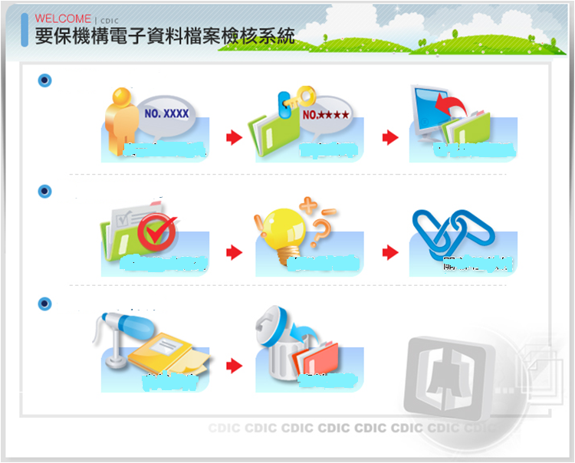
Inspection of the E-data Files
EDFs Inspection System
Import File
i. Code import
ii. Code setting
iii. E-data files import
Check File
iv. File format check
v. Reasonableness
check
vi. Interrelated fields check
Complete Inspection
vii. Inspection report
viii. Data deletion

Slide 25
Inspection of the E-data Files
EDFs Inspection Procedure (1)
Self-check by insured institutions
Simplified version of “E-data Files Inspection System”
On-site inspection by CDIC
CDIC’s inspection team is arranged to conduct on-site inspections of insured institutions. Institutions with higher risks would be inspected first
If necessary, CDIC conducts a re-inspection of the institution that has completed the revisions of deficiencies
If an insured institution is about to fail, the scope and depth of the inspection will be strengthened

Slide 26
Inspection of the E-data Files
EDFs Inspection Procedure (2)
Preparations prior to inspection
Decide inspection schedule
Inform the insured institutions to prepare data files based on designated standard date
Utilize the “E-data Files Inspection System” to download the related inspection data from CDIC’s database.
CDIC’s IT system for pre-inspection preparations
Pre-arrange inspection schedule
Edit the notification of inspection
Edit, upload and download the inspection report

Slide 27
Inspection of the E-data Files
E-data Files Inspection Flow
Importing the insured institution’s E-data files and tables of codes to the system
Report of
file data count
incorrect data length and type
File record length and types check
Incorrect
Correct
Insured institution
Incorrect
Data completeness
List of Incorrect data
Reasonableness check:
content of fields / interrelated fields of files
Incorrect
A

Slide 28
Inspection of the E-data Files
E-data Files Inspection Flow
A
Data accuracy
(manual random check)
Incorrect
Insured institution
Communication with the insured institution about the inspection findings
Delete e-data files from the system
Sending a written report to the insured institution
Tracing inspection deficiencies of the insured institution for the improvement

Slide 29
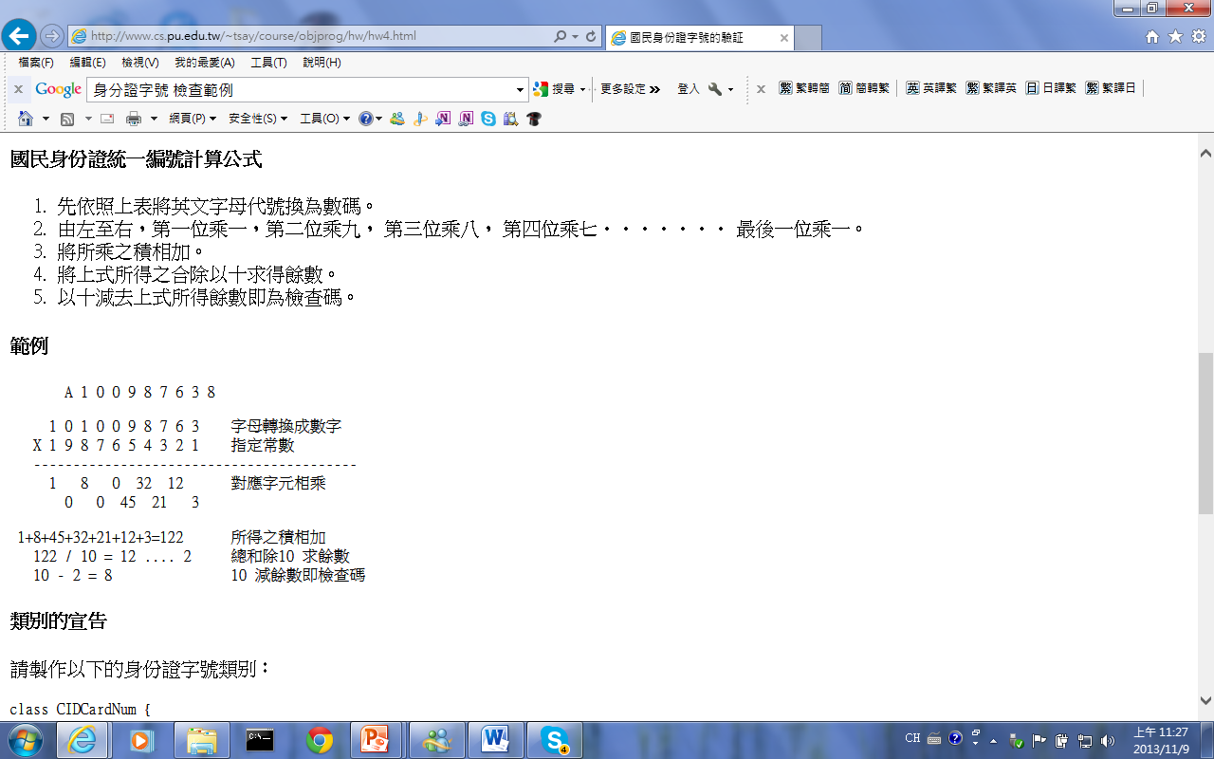
Inspection of the E-data Files
Reasonableness check (1)
Content of fields
Code of fields with the regulatory scope
Customer ID is a PIN, BAN, BIN, Resident Visa Number(RVN) or Business Tax ID
Customer ID meet checksum formula
Different Customer IDs but have same Customer names and dates of birth or addresses
Date of birth field is between 1900/01/02 and computer system date
Accrued interests of time deposit field can’t be 0

Slide 30
Inspection of the E-data Files
Reasonableness check (2)
Interrelated fields of file
Balance of deposits & loan data file vs. accounting balance data file by account code
“Customer ID” of deposits and loan data files vs. customer basic data file
Controlling account, certified and cashier‘s check list file vs. deposit data file by account no.
Balance on the depositor’s passbook +(-) un-entry transaction ＝ balance on account in demand deposit file
Time deposits pledged as collateral file vs. Time deposit file and load data file
Loan guarantors file vs. loan data file and customer basic data file

Slide 31
Inspection of the E-data Files
On-site Inspection Deficiencies (1)
i. Part of the e-data files are incomplete, e.g. loan guarantors file
ii. The content of some fields is incorrect or blank
iii. Individual customer uses different customer ID number to hold many deposit accounts
iv. The “accrued interest” field under the deposit files is not calculated till the inspection standard date or shows “0”

Slide 32
Inspection of the E-data Files
On-site Inspection Deficiencies (2)
v. Inconsistency among interrelated fields of cross-files
vi. Operation of establishing e-data files is not included in the internal audit of insured institutions
vii. In respect of joint accounts and dormant custodian accounts, the detailed information of related customers is not complete
viii. The depositors’ information, like address and telephone number, is incomplete or not updated. This may have impact on the delivery of payout notice

Slide 33
Payout Flowchart
Inspection of the E-data Files
CDIC
Insurer
Receiver
e-data fiel Inspection System
Before closure: preparation
Payout & Advance Dividend System
At closure: deal with payout & advance dividend data
+
Maintenance of data
Payout to insured depositors
Dividend of proceeds of liquidation
to uninsured depositors and creditors
(CDIC subrogation)
Payout termination
Liquidation completion

Slide 34
Inspection of the E-data Files
Payout & Advance Dividend IT System
Schedule of developing the IT System
1st stage (by the end of 2011)
Simple payout without netting and on-line processing for all payout locations
2nd stage (by the end of 2013)
Whole payout system completed
Payout simulation plan
Scheduled to conduct simulations

Slide 35
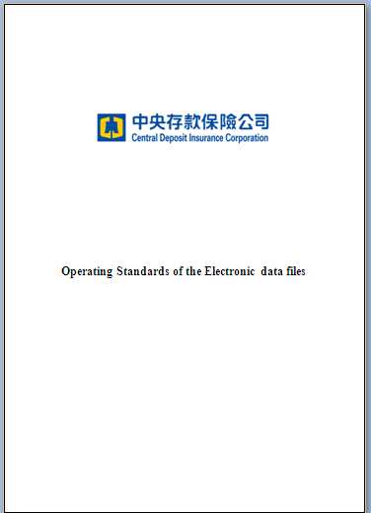
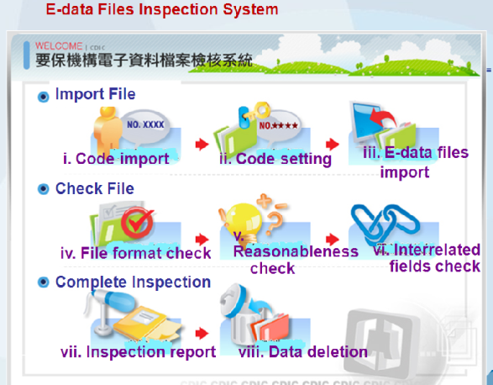


Inspection of the E-data Files
System Enhancements
Enhance
Upgrade
Inspection System
On site inspection
Payout Simulation
Modify EDFs format
special errors or problems

Slide 36
4. Challenges and Conclusion

Slide 37
Challenges and Conclusion
Challenges in Establishing the EDFs (1)
Insured institutions cannot submit the complete e-data files because business transactions in early stages were done manually and accounting books were simplified, but the customers currently no longer carry on any business with the insured institutions.
The data file format, items and processing method of each insured institution are slightly different, so the institutions’ IT systems have to be revised.

Slide 38

Challenges and Conclusion
Challenges in Establishing the EDFs (2)
Some insured institutions outsource the information operation, so inspection deficiencies have to be handled with the assistance of outsourcing companies. It takes much longer time.
Some individual customers use different customer identity codes to open many deposit accounts, but the insured institutions failed to update those data until depositors come to counter.

Slide 39
Challenges and Conclusion
Conclusion
Require insured institutions to establish e-data files in advance and make the requirement stipulated by law or regulation
Conduct inspection and pay attention to the institutions revision of deficiency
Build up an IT system to assist with handling e-data inspections and management
Strengthen the scope and depth of inspection when the institution is about to fail

Slide 40
Thank You!

