Slide 1


Depositor Reimbursement System of KDIC
Chul Hee Yoon
Team Leader, Department of Savings Bank
Rehabilitation and Resolution
Korea Deposit Insurance Corporation

Slide 2
Table of Contents
KDIC’S DI Payment System
Investigations in Preparation for Payment
Overview of IRIS and the Payment Process
A Demonstration of the Online Process for Filing a Claim

Slide 3
I. KDIC’s DI Payment System

Slide 4
Overview of the DI System in Korea
Objectives
Protect depositors and maintain stability of the financial system
Integrated Deposit Insurance Scheme
Banks (56), Securities Firms (119), Life Insurers (24),
Non-life insurers (23), Merchant Bank (1), MSBs (92)
Local branches of NongHyup and SuHyup, the National Credit Unions’
Federation of Korea, the Community Credit Cooperatives and
the Post Office are not KDIC-insured
Risk-Minimizer
Joint examinations and information-sharing, independent investigations
Failure resolution functions
Conservator and receiver of failed financial institutions

Slide 5
Overview of the DI System in Korea
Compulsory Membership
No termination right
Coverage Limit: KRW 50m (equivalent to USD 47,014)
Foreign currency deposits covered
Inter-bank deposits or deposits made by the central government,
local governments, BOK, FSS or the KDIC not covered
Investment products such as beneficiary certificates, funds and
subordinated bonds not covered
No co-insurance
Funding
Premium rate: 0.08% - 0.40% (Risk-based premium from 2014 )
Reserve target: 1.650% - 1.925% of insurable deposits(MSB)

Slide 6
Types of Insurance Events
Category - 1 : Suspension of payment of liabilities including deposit liabilities
  The financial institution has become so distressed that it cannot repay
  deposits. Or the Financial Services Commission (FSC) ordered the financial institution to suspend payment of deposits
  [Articles 31 and 34 of the Depositor Protection Act] Within two months of the notification of the insurance event, it has to be decided whether or not to pay deposit insurance through a resolution of the Deposit Insurance Committee
Category - 2 : Revocation of business license or permit, a resolution of
dissolution or declaration of bankruptcy
  The FSC withdraws the financial institution’s business license or permit. Or the institution decides to dissolve itself or is declared bankrupt by the court
  [Article 31 of the Depositor Protection Act] Without having wait for a decision, the KDIC initiates the deposit insurance payment process upon request of depositors, etc

Slide 7

Decision-making Process for the Payment of
Deposit Insurance and Advance Dividends
Standard Procedure for Failure Resolution without Any Disruption to Financial Services
Declaration of Insolvency
The financial institution is declared insolvent and the FSC issues an order for
business improvement
Investigations in Preparation for Payment
The financial institutions is asked to submit data necessary to determine
deposit insurance claims
Preliminary investigation in preparation for the payment of deposit
insurance and advance dividends.
Investigation of fund flows to withhold payment to people responsible for
the institution’s failure and other people related to them
Payment Decision
The Deposit Insurance Committee decides to pay deposit insurance and
advance dividends
The FSC approves the decision to pay advance dividends
Business Suspension and the Decision to Conduct a P&A
Business suspension and the decision to conduct a P&A (FSC, on a Friday)
Notice in newspapers for the payment of deposit insurance and advance
dividends (on the following Saturday)
Payment
Start of payment through agent banks and the Internet (on the next Monday)
* As the highest decision-making body in regards to financial policy-making, the FSC has the authority to issue
business licenses and permits, examine financial institutions and impose restrictions.
* The Deposit Insurance Committee is the highest decision-making body to review and decide key issues of the KDIC.
7

Slide 8
Types of Payment; Interim Payment
Interim payment ?
  In situations where payments cannot be made right away, the KDIC makes
  interim payments upon request of depositors in amounts determined
  by the DI Committee
Timing of Payment : Within four days after the occurrence of the insurance event
Who are Eligible : All depositors (excluding those who have more debts than deposits with the institution or those for whom payments have been withheld)
Payment limit
Depositors with deposits in excess of the coverage limit
: Up to 40% of principal (within the limit of KRW 50 million)
Depositors with deposits under the coverage limit
: Up to KRW 20 million for principal only

Slide 9
Types of Payment; DI Payment
DI payment ?
  When an insurance event occurs, the KDIC reimburses depositors on behalf of the failed financial institution
Timing of payment : The next business day after the insurance event(MSB)
Who are Eligible
  When the FI is liquidated : All depositors
  When the FI is resolved through a P&A transaction
  : All depositors excluded from the P&A transaction
Payment limit
  Up to KRW 50 million including principal and designated interest
  Usually, the KDIC-announced rate is lower than the contractual rate. So, using designated interest rates has the effect of reducing moral hazard of financial institutions and depositors
  * Designated interest rate is the lesser between the KDIC-announced interest rate and the contractual rate
  KDIC-announced interest rate is the average interest rate on one-year term deposits
  offered by 11 commercial banks in the country.

Slide 10
Types of Payment; DI Payment(Cont’)
Changes in the Coverage Limit
The coverage limit has been adjusted a few times since 1997 in consideration of economic conditions, GDP levels, inflation, etc
Time | Coverage Limit | Note
Jan. 1, 1997 ~ Nov. 18, 1997 | KRW 20 million
Nov. 19, 1997 ~ Jul. 31, 1998 | Blanket coverage based on contractual interest rates | Bailout loans from the IMF
Aug. 1, 1998 ~ Dec. 31, 2000 | Deposits made before Jul. 31, 1998 Blanket coverage based on contractual interest rates Deposits made on or after Aug. 1, 1998 Deposits worth KRW 20 million or less : Up to 20 million including principal and designated interest Depositor worth more than KRW 20 million : Full coverage for principal
After Jan. 1, 2001 | KRW 50 million including principal and designated interest

Slide 11
Types of Payment; Advance Dividend Payment
Advance Dividend Payment ?
The KDIC buys claims for the uninsured portion of deposits from depositors and pays them advance dividends in consideration of the estimated payment ratio from the receivership of the failed financial institution
Timing of Payment : At the same time as DI payment (needs the FSC’s approval)
Who are Eligible : Depositors who have claims such as deposits in excess of the coverage limit
Calculation
  Advance dividends = Deposit claims to be purchased by the KDIC * The estimated dividend payment ratio
Account Settlement
  Before the bankruptcy process is completed, a comparison is made between the amount of advance dividend and the actual amount of bankruptcy dividend and the difference is paid or received
Notes:
개산지급률은 예상 파산배당률과 선지급에 따른 할인율을 고려하여 산정
정산시 공사 배당금을 통해 회수한 금액에서 소요비용을 공제함을 설명 필요

Slide 12
Relevant Staff
KDIC Staff Members in Charge of DI Payment, etc.
  Depositor Reimbursement Team(8 members)
    Four full-time examiners
    16 other staff members on standby in case many FIs fail at the same time
  Information System Team
    Two full-time staff members to manage the deposit insurance payment system
Agent Banks
  Agreements with six commercial banks to provide payment services
  In case of an insurance event, payments can be handled quickly by utilizing the branch networks and human resources of the agent banks

Slide 13
Number of Financial Institutions for
Which the KDIC Paid Deposit Insurance
Number of FIs for which the KDIC paid deposit insurance by sector
Sector | Before 2003 | 03-04 | 05-06 | 07-10 | 11-13.6 | Total
Merchant Banks | 19 | - | - | - | - | 19
Securities Firms | 4 | - | - | - | - | 4
Savings Banks | 70 | 2 | 3 | 9 | 26 | 110
Credit Unions* | 327 | - | - | - | - | 327
Total | 420** | 2 | 3 | 9 | 26 | 460
* Credit unions were excluded from KDIC coverage in 2004 when the Depositor Protection Act was revised. Now they are protected by their own fund ** Includes resolutions just after the Asian Financial Crisis in 1997
Notes:
13
보험금을 주로 지급하는 금융권역은 저축은행과 신협임을 언급 필요

Slide 14
Recent Cases
Payment of Deposit Insurance for 26 Failed Savings Banks (2011 ~ 2013.6)
(Number of people, KRW bil.)
 |  |  | # of People |  | Amount
Amount of Deposits | Total |  | 1,721,740 |  | 35,597
 | Under the Coverage Limit | 1,650,431 |  | 35,174
 | Above the Coverage Limit | 71,309 |  | 423
Types of Payment | Interim Payment |  | 853,053 |  | 11,749
 | DI Payment |  | 71,959 |  | 2,265
 | Advance Dividends |  | 63,885 |  | 78
Initial cost of resolution & payment for 26 failed savings banks
  KDIC’s initial cost was KRW 26.5 trillion
  A special account was created in the DI Fund to finance the cost of savings bank restructuring. For the next 15 years, 45% of all premiums paid by other financial institutions will be placed into this account
Notes:
14
스크립트에 모두 제1종 보험사고임을 언급 필요

Slide 15
II. Investigations in Preparation
for Payment

Slide 16
Flowchart of the Investigation Process
Repeat 3-4 times
4 Basic data items
Failed Savings Bank
Check the data format
Check the balance of deposits,
loans, interest, tax, etc
Data extraction for the calculation of deposit insurance claims
4 basic data items +
17 additional data items
Verification Process
17 Additional data items
Payment suspension
Verification of additional loan data
Exclusion from coverage
Separation from personal deposits
IRIS calculation process
Suspension of payment
Calculation of the amount of deposit insurance to be paid
Set-off
4
3
2
1
Determination of deposit amounts to be suspended from payment
Responsible parties and people related to them are suspended from payment
Deposits seized and deposits pledged to a third party are held back from payment.
For depositors who have deposits furnished as collateral or have guaranteed obligations, the corresponding amount is held back from payment.
For individual depositors, their loans are set off against the balance of their deposits.
Check whether the net deposit amount exceeds the coverage limit(KRW 50 million) or not
(Verified) Final data
(after checking the data collected as of the day of bank closing)
Input
Determination of the amount of deposit insurance due to each depositor
End of the deposit insurance calculation process
Determination of net deposits
16
Notes:
압류/압류된 예금 및 기타 그 권리에 관한 다툼이 있는 예금에 대해서도 해당 사유가 해소될 때까지 지급을 보류함.

Slide 17
Data Needed for the Investigation
The legal basis for the KDIC’s authority to request depositor data
in advance of a failure
  The Depositor Protection Act (DPA) allows the KDIC to request data necessary for the determination of deposit insurance liabilities from member institutions
  A total of 21 Items (4 Basic Items + 17 Additional Items)
  4 Basic Items of Electronic Data
Article 21 of the DPA (Request to Insured Financial Institutions for the Submission of Data)
① The KDIC may request an insured financial institution and its parent financial holding company, etc. under the Financial Holding Companies Act to submit data related to the business and financial status of such insured financial institution and financial holding company to the extent necessary for carrying out its duties, such as the calculation and payment of deposit insurance, and the resolution of insolvent financial institutions
Customer Data
Claims/Obligations Data
Pledges/Collateral Data
Incident Reports
ID number, phone
number, address, etc.
Balance of deposits
and loans, interest
payment information,
interest rate, etc.
Customer’s guarantee
liabilities and history of
collateral pledging
List of accounts
reported for incidents
such as suspension of
deposit withdrawals

Slide 18
Data Needed for the Investigation(Cont’)
  17 additional Items of Electronic Data
List of Items | Purpose | Description
People affiliated with the executives and employees of the bank | Payment Suspension | For immediate relatives of the executives and employees of the failed bank, the KDIC can suspend payment of deposit claims.
Large shareholders and people affiliated with them |  | For large shareholders and people affiliated with them, the KDIC can suspend payment of deposit claims.
Deposits of the executives and employees of the bank |  | For executives and employees of the failed bank, the KDIC can suspend payment of deposit claims.
List of special claims |  | If a borrower or a guarantor of a debt that has been written-off is also a depositor, the KDIC can suspend payment of part of his/her deposit claims equal to the amount of the debt.
List of deposits seized (including provisional seizure) |  | For deposits whose ownership is disputed in court, the KDIC can suspend payment of deposit claims until the issues are resolved.
List of deposits whose withdrawal has been suspended |  | For deposits whose withdrawal has been suspended after an incident report, the KDIC can suspend payment of deposit claims.
List of pledges established by third parties or other financial institutions |  | For deposits pledged to a third party, the KDIC can suspend payment of deposit claims until the issues are resolved.
18

Slide 19
Data Needed for the Investigation(Cont’)
  17 additional Items of Electronic Data (Cont’)
List of Items | Purpose | Description
List of suspense payments that are related to loans | Deduction of Debt Obligations | Legal fees and other expenses associated with a delinquent loan should be paid by the depositor/debtor. So the corresponding amount is deducted from deposits.
List of loans made to the bank’s employees |  | Loans made to employees as part of welfare benefits are loans, too. So the corresponding amount is deducted from deposits.
List of subordinated debts | Exclusion from Coverage | Subordinated debts are not KDIC-protected.
List of deposits whose prescription period for claim of payment has expired |  | Deposits whose prescription period for claim of payment has expired are excluded from coverage.
List of uninsured deposits |  | Deposits on this list are excluded from coverage.
List of deposits made by any organization | Separation from Personal Deposits | Deposits made under the name of an organization, corporate or non-corporate, are separately protected from personal deposits.
19

Slide 20
Data Needed for the Investigation(Cont’)
  17 additional Items of Electronic Data (Cont’)
List of Items | Purpose | Description
List of deposits and loans owned by customers who appealed against the KDIC’s asset investigation finding | Other | Deposits and loans owned by customers who appealed against the finding of the KDIC’s asset investigations
List of deposits for which their owners do not want preferential tax treatment (including tax exemption) |  | For deposits for which their owners do not want preferential tax treatment, ordinary tax rates will apply.
List of deposits whose maturity has been passed |  | Deposits whose maturity has been passed of the date of DI payment announcement
List of suspense receipts that are similar to deposits |  | Suspense receipts that are more like deposits in nature are treated as ordinary deposits.
20

Slide 21
Verification of Data to Determine DI Claims
D-day
(bank closing,
usually a Friday)
Before
D-28
D-21
D-17
D-14
D-10
D-7
D-1
D+1
1st data
gathering
2nd data
gathering
(D-17 days)
3rd data
Gathering
(D-10 days)
4th data
gathering
(D-1 day)
Confirmation
Request for data submission
1st verification
Modification
2nd verification
Modification
3rd verification
Modification
Reflection of data changes
Final verification
Check basic data items
Reflection of data changes that happened due to transactions during the day
4 basic data
items + 17
additional data
items
Development
of a program
to extract data
(Failed Savings
Bank)
Cross-check of financial statements and submitted data
Whether interest has been calculated correctly using the prescribed interest rate
Checking of tax rates applied to different kinds of deposits
Data as of the D-day
Final checking of
balance, interest and
tax details
Check for any
omission from the list
of deposits for which
deposit payment
should be withheld
Check additional data items
Check to see if there are any other cases of payment suspension and exclusion from coverage
For deposits made by group organizations,
it has to be checked if the documents
submitted are correct.
Uploading of the
final data to the IRIS
and preparations
for deposit payoffs
Create data for the suspension of payment for people who are responsible for the bank failure and people related to them based on the submitted data and findings from fund flow investigations
21

Slide 22
Payment Suspension for People Responsible for the Bank Failure
Under the DPA, the KDIC is allowed to withhold payment of deposit insurance for
people who are responsible for a bank failure and people related to them
for up to six months
Work Process
Withhold payment for up to 6 months
Deposits related
to people
who are responsible for
the bank failure
Suspension of payment for responsible parties
Accountability investigation
Responsibility
Measures to secure claims
(e.g. provisional seizure of assets)
Suspension of payment for people who are related to responsible parties
Investigation of fund flows
No responsibility
Deposit reimbursement
Deposits NOT related
to people who are
responsible for
the bank failure
No suspension of payment
Deposit reimbursement

Slide 23
III. Overview of IRIS and the Payment Process

Slide 24
Overview of IRIS
IRIS : Integrated Resolution Information System
  Supports all resolution processes : resolution planning, management of resolution, payment of deposit insurance, etc
Purpose
  Ensure the systematic and efficient conduct of resolution proceedings
  Increase depositors’ convenience through prompt payment of deposit insurance
History
  Developed for 14 months (Jul. 2007 ~ Sept. 2008) for a fee of nearly KRW 2.4 billion
  December 2008 : Started to be used for making payments at agent banks’ teller counters
  January 2009 : Began online payment services
  August 2011 : Enhanced the system to enable the handling of many requests at the same time
  December 2012 : Improved the functions related to online payment services

Slide 25
Overview of IRIS ; An Overall Map of the System
USERS
IRIS
Internal Systems
Depositor
Standard Business Manual
Appointed Conservator
Receiver
KR & C
Profile of FI
Financial Information Analysis System
Bridge Bank
Agent Bank
Resolution Cases
Recovered Assets
Case files
5W1H
Documents
Failed Banks Asset Management System
Accounting Firm
M&A Advisory Firm
External Systems
Resolution
Payment
Planning
Valuation
Bid info.
Recovery
information
Mgmt of Payment Data
(Interim, DI, Advance Dividends)
Resolution
planning,
Mgmt of
bridge
bank’s legal
affairs
Deposit
Schedules
Failed Bank
Dividend
Payment Ratio
Bankruptcy Claims & Dividends
System
Firm Banking Institution,
Certification Authority
25
Common Tech. Environment
Security

Slide 26
IRIS’s Payment Functions ; Key Functions
Data management, calculation, payment and account settlement for interim payments, DI payments and advance dividend payments
Managing the list of deposits (depositors) held back from payment
Managing the expiration date of DI claims
Enabling agent banks to enter claims filed in the system and make payments
Viewing of data and filing of claims over the Internet
System operation management including firm banking services
 User must go through the approval process for payment or changes of data, and IRIS makes logs of every data modification

Slide 27












IRIS’s Payment Functions ; A More Detailed Map
IRIS
Log-in
Web
Server
Application
Server
Communication Server
(For On-Line Payment)
DB
Firewall
KDIC staff
Remote Support
Duplicate
Depositor
Firewall
R
A
C
Internet
Electronic Transaction
Intermediary
Load
Balancing
Equipment
Firm banking
Agent Bank
on Standby
4 ~ 16
Servers
2 ~ 5
Servers
2 Servers
Agent Bank
Agent
Bank
Agent
Bank Teller
Agent
Bank staff
Storage
Visit in Person
Depositor
Certifying
Authority
Certification Service Provider
Depositor’s Account
Payment Service by Agent Banks
Notes:
지급대행기관에 예치된 공사예금계좌에서 예금자가 입금을 요청한 계좌로 실시간 송금 처리

Slide 28
Infrastructure in Place to Handle
Many Payment Requests at the Same Time
Flexible Use of Agent Banks
  Increase the number of agent banks from 1 to 6
    The KDIC can use their branches near the failed bank and their human resources
  Manage the number of branches and tellers in a flexible manner
    Not exceed 500 depositors per branch
Handling of Many Claims via the Internet
  Enhancement of system resource and performance
    Web server (4 -> 16), Application Server (2 -> 5), Network Bandwidth (400Mbps -> 1Gbps), load balancing to route requests for firm banking
  IRIS has the capacity to handle up to 100, 000 concurrent users

Slide 29
Notice to Depositors Regarding Payment
  Notice in Newspapers and on the KDIC Website
    Publish a notice of payment in two or more daily newspapers more than once(The DPA requirements)
    On the KDIC website, a separate page is created to inform depositors of the eligibility criteria, payout period, claims filing process and some FAQ
Notice to Individual Depositors in Mail and texts
    Send notices to individual depositors in mail and text them, too
    Send mail and make a call periodically for those who don’t file claims
Call center and Remote Support
    Operate a call center to answer questions from depositors
    Provide remote support for depositors who have trouble filing claims via the internet

Slide 30

Payment Process ; Online Filing of Claims
Request
Payment
1. Log-in using a digital certificate
1. Verification of the request
Depositor
2. Inquiry about deposits
Manager of KDIC
2. Approval of the money transfer
request
3. Input of account information to
which the deposits are to be
transferred
Certification Authority
3. Money transfer:
Immediate wire transfer
through firm banking
services
‘VAN’ Company
4. Consent to the transfer of
claims to the KDIC
5. Certification through a
credit card or a mobile phone
Personal Identification
Service Agency
6.Electronic signature
Depositor’s Account
Agent Bank
* A digital certificate is an electronic document issued by a certification authority to identify the holder of the certificate
and prevent forgery or denial of transaction submissions. It is something like a digital seal used in electronic commercial
transactions.
30

Slide 31
Payment Process ; Personal Visit to an Agent Bank Branch
Request
Payment
Visit to an agent bank branch
(by the depositor): six commercial
banks acting as agent banks.
1. Verification of the request :
Log onto IRIS and
verify whether
the depositor information
is consistent with the one
in the system
Agent Bank
Staff
Depositor
2. Presentation of an ID and
filing a claim
3. Signing of a form to provide
consent to the transfer of
claim to the KDIC and other
documents
Certification
Authority
2. Approval of the money transfer request
‘VAN’ Company
Agent Bank
Teller
3. Money Transfer :
Immediate wire transfer
through firm banking
services
4. Log-in using a
digital certificate and ID/PW
5. Register the claim data to IRIS
Agent Bank
Certification Authority
Depositor’s Account
31

Slide 32
Real-time Payment Using Firm Banking Services
Firm Banking
Firm banking services
  Computer systems of a company and a financial institution are connected through communications networks so that banking services (e.g. real-time money transfer) can be conducted online
  Using the system of an electronic transaction intermediary, a company can be connected with many financial institutions
  - This enables the KDIC to be connected with multiple agent banks, which increases its processing speed and disaster handling capacity
When a request for payment goes through, the money can be wired real-time to the depositor’s account through firm banking services
KDIC
(IRIS)
Electronic
Transaction
Intermediary
Agent Banks
The depositor’s
account to receive
the payment

Slide 33
IV. A Demonstration of the On-line Process for Filing a Claim

Slide 34
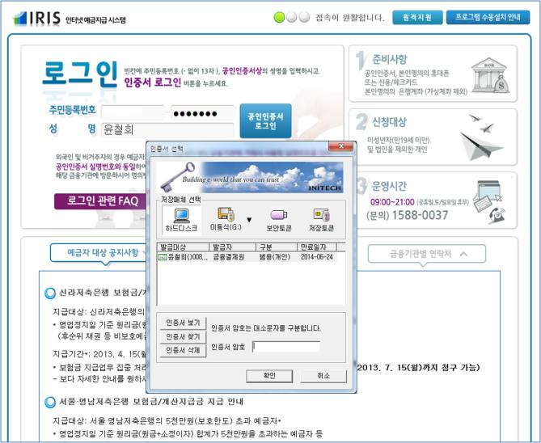
Log-in
The depositor goes to the website (http://dinf.kdic.or.kr) and logs onto the system using a digital certificate
0

Slide 35
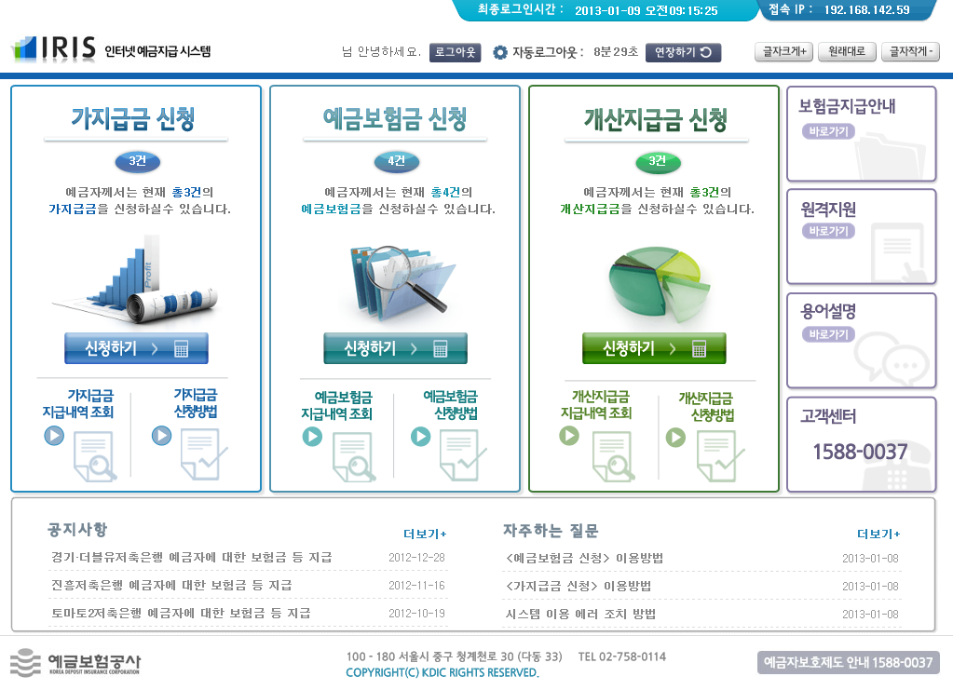

Start of the Claims Filing Process
To start the process, the depositors chooses among: interim payment, deposit insurance payment and advance dividend payment
Click

Slide 36
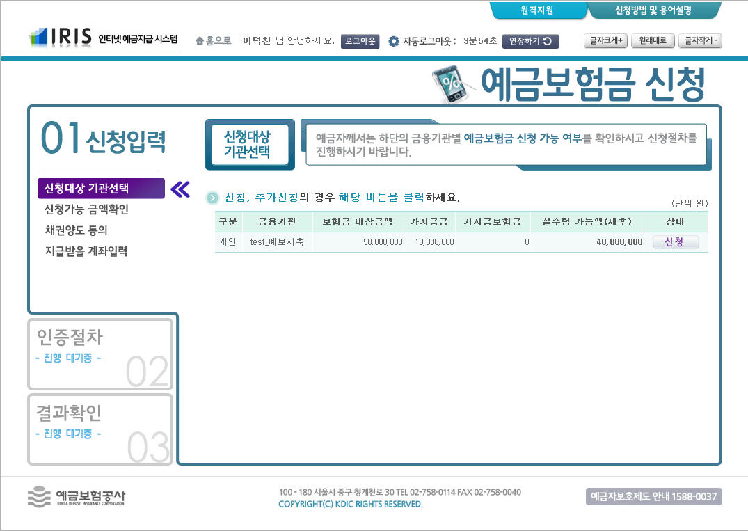
Click on the Name of the Bank
The depositor sees the name of bank and the amount of deposit insurance he/she is entitled to and clicks on the “Proceed” button
Click

Slide 37
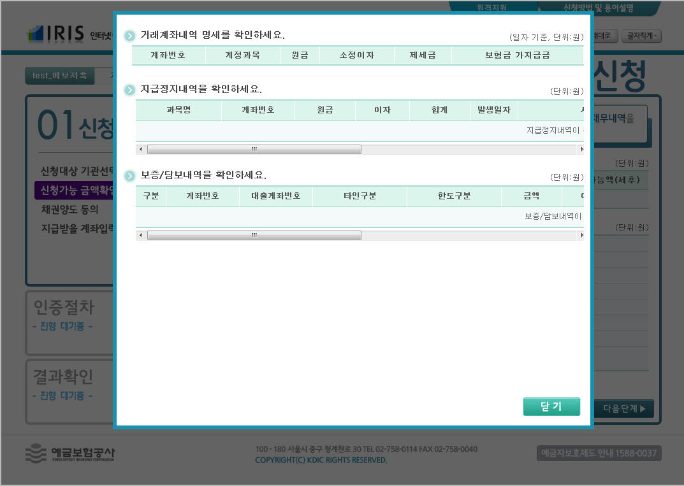
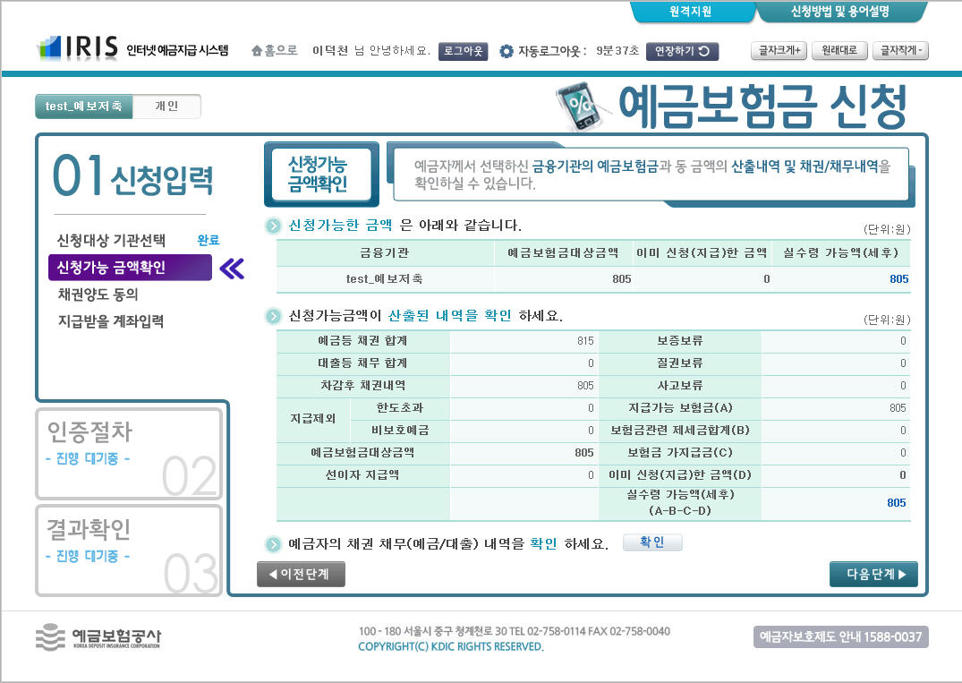

Check to See if the Amount Is Correct
A table appears to show how the amount was calculated
  The depositor can also view his/her deposits by account number and any outstanding debts with the bank
click

Slide 38
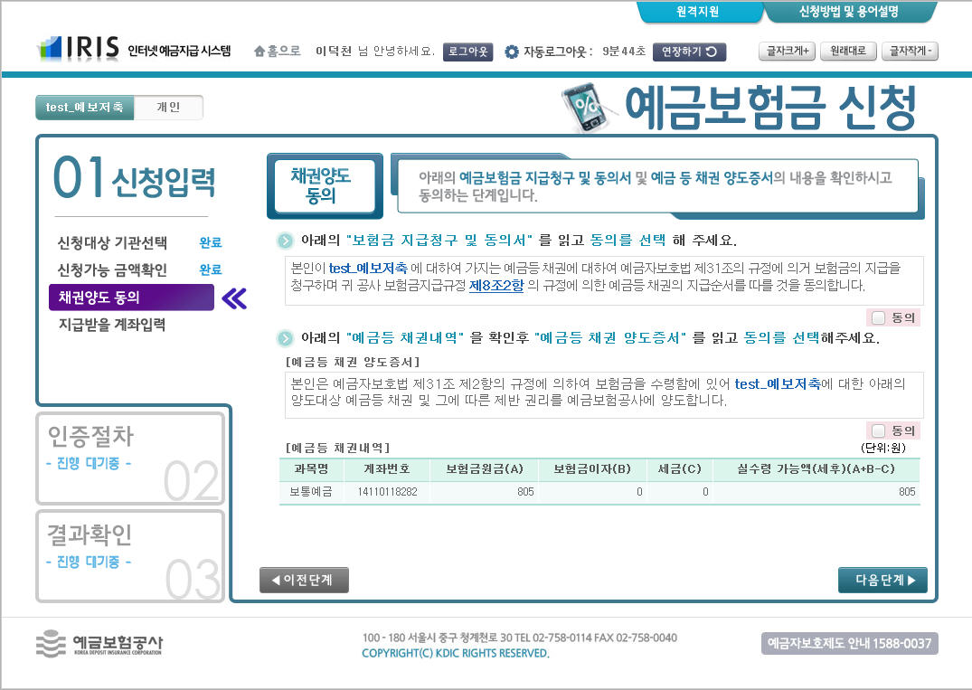
Filing a Claim and Providing Consent to
the Transfer of Claim to the KDIC
The depositor ticks the boxes to indicate his approval for filing a claim and transferring his/her claim to the KDIC
check

Slide 39
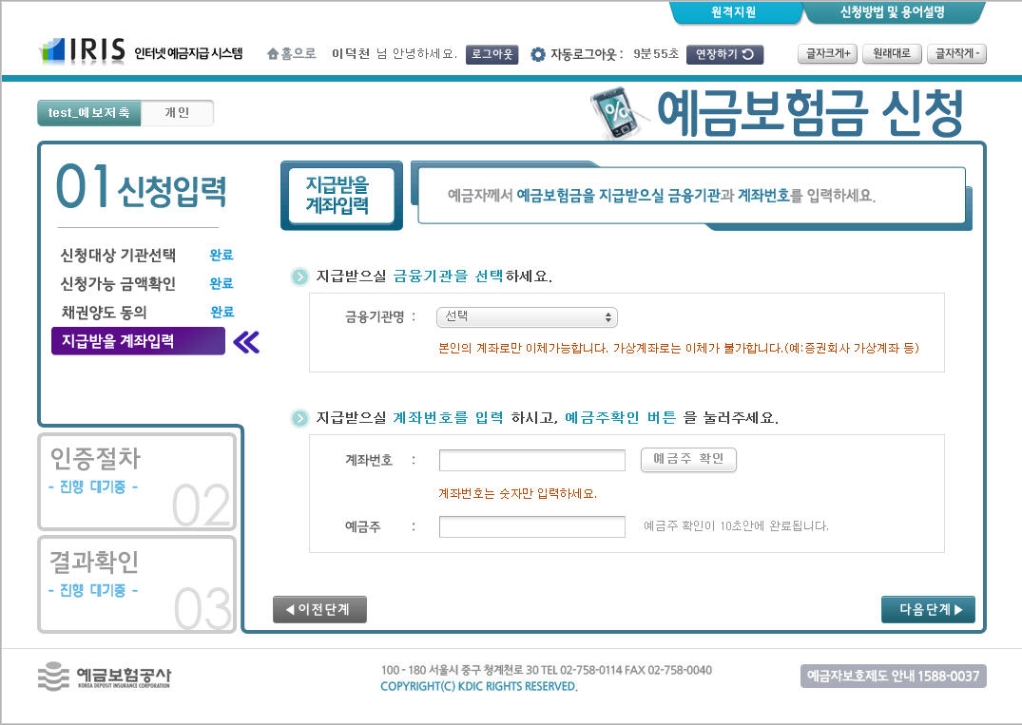
Provide the Account to Which
the Payment Should Be Sent
The depositor chooses the name of the financial institution and enters the number of the account where he/she wishes to receive the payment
  IRIS verifies that he/she is the account holder

Slide 40
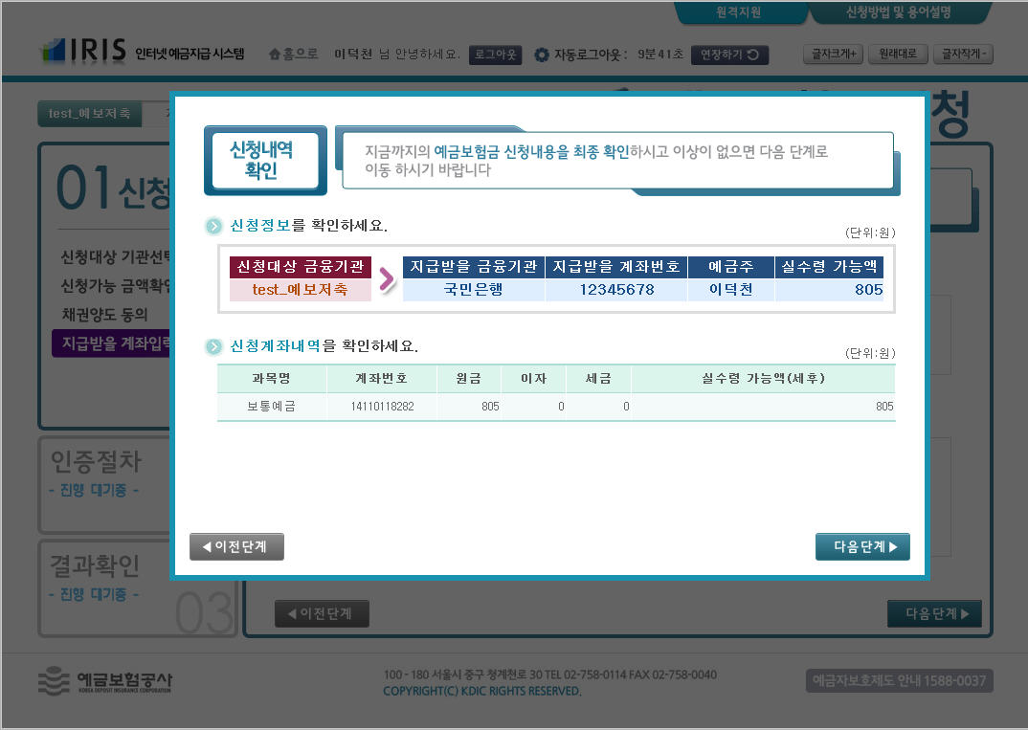
Check the Data Entered
The depositor confirms the data entered

Slide 41
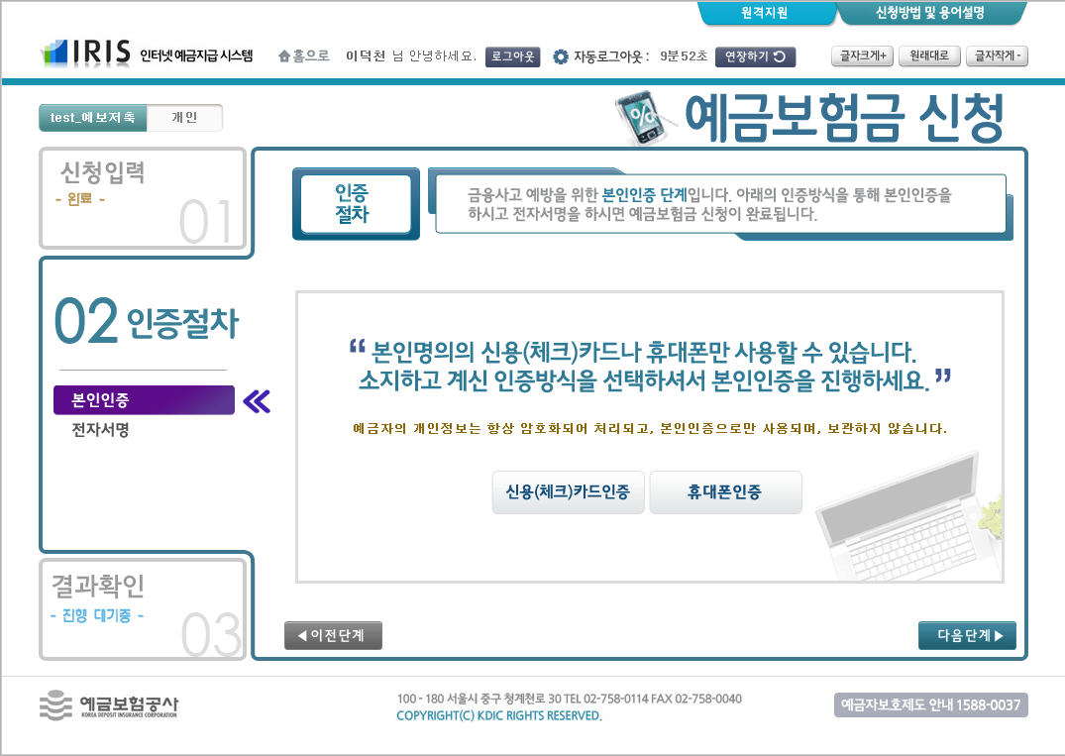
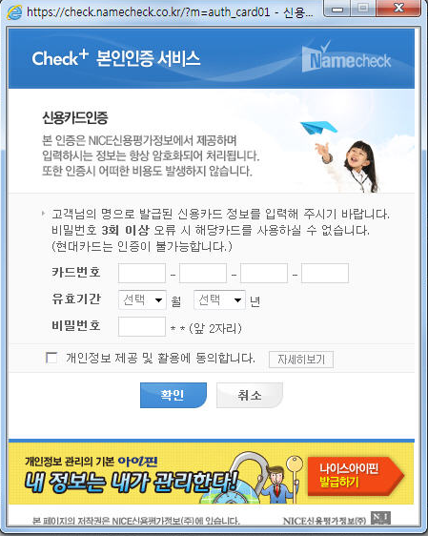
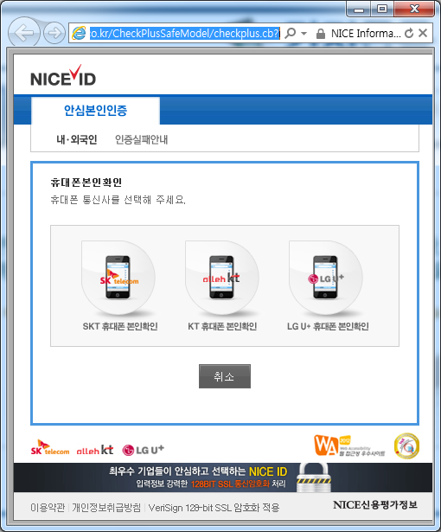
Personal Authentication
  To prevent a fraud, the depositor has to confirm his/her identity through a credit (debit) card number or a cell phone owned under his/her name
click

Slide 42
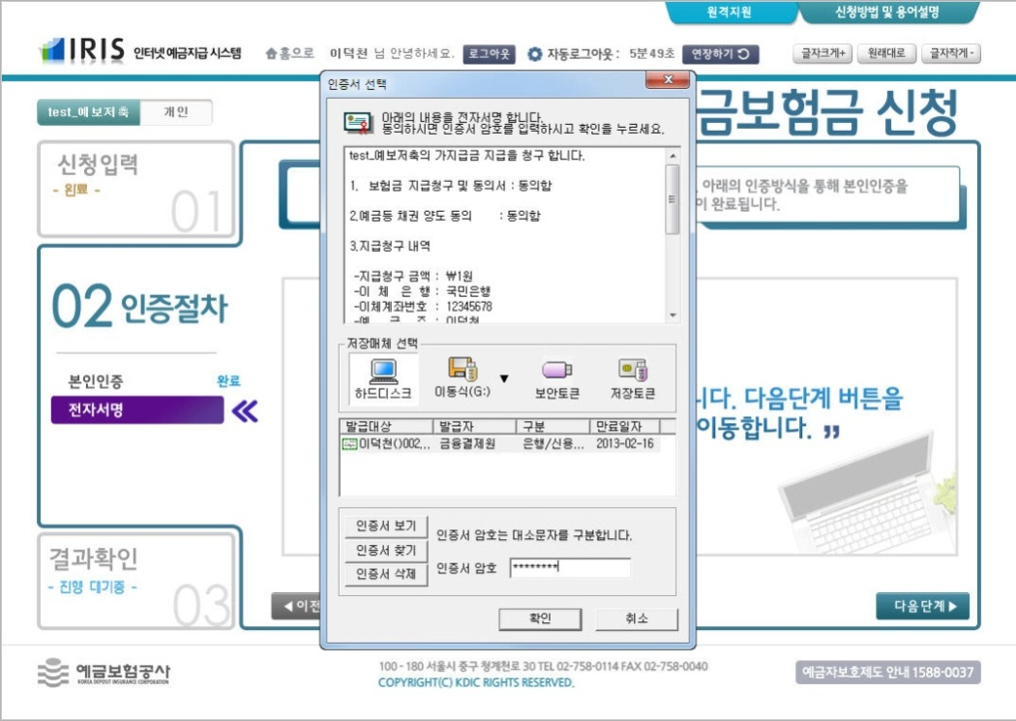
Electronic Signature
After a final check of the amount of claim, account information and other details,
the depositor submits an electronic signature

Slide 43
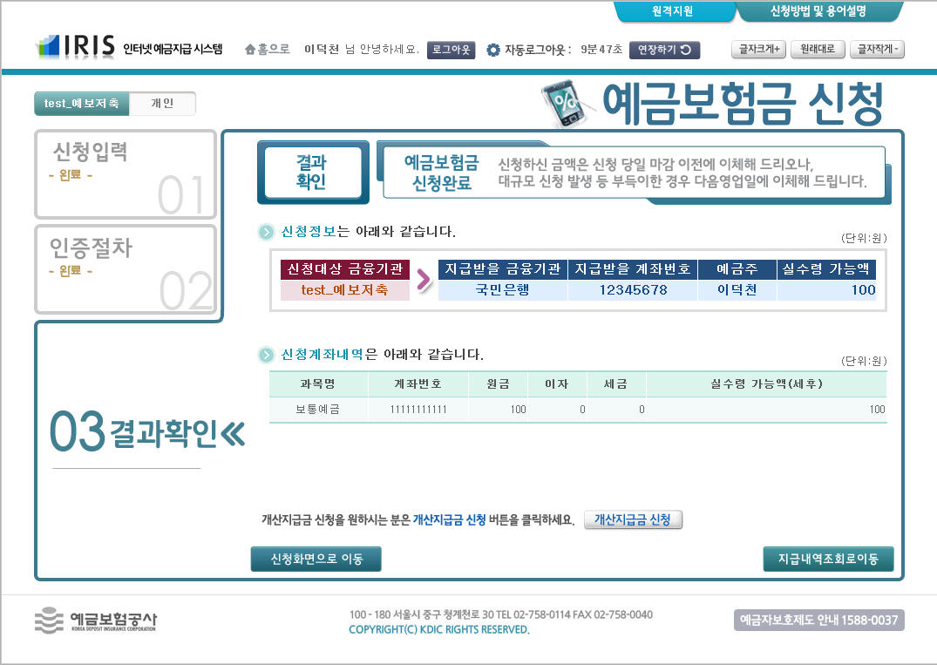
Check the Result
After checking that a claim has been filed, the process is completed

Slide 44
Thank you for your kind attention!
Chul Hee Yoon
chyoon@kdic.or.kr

