Slide 1

Effective Automation Reimbursement in the private banking sector in Germany Olaf Hartenfels Deposit Protection and Trust Company, Cologne
Claims Management: Reimbursement to Insured Depositors
2 – 4 December 2013
Taipei, Taiwan

Slide 2
Outline
Basics about safety net in Germany
Short overview of reimbursement in Germany
IT-tools
„EAEG presenter data file“
Auditing the EAEG presenter data file

Slide 3









Basics Three Categories of banking business
Supervisory Authority
Private commercial banks
Cooperative banks
Public Sector banks
2 DGS
Institutional protection scheme

Slide 4



Basics German Deposit Guarantee Scheme
German Banks Compensation Scheme
Statutory
„basic cover“ up to € 100.000
Auditing Institution for the deposit protection System
Deposit Protection Fund
Voluntary
30% relevant liable capital

Slide 5
Basics Task and services of the Auditing Association
Auditing Institution for Deposit Protection Fund (ESF)
and Compensation Scheme of German Banks (EdB)
175 member banks
Deposit protection audits
Admission and ownership control
Other risk management activities for deposit insurance
In addition: Audits 50 banks which only belongs to the EdB
www.pv-banken.de

Slide 6




Basics
Affiliated companies of the Auditing Association of German Banks
Notes:
.

Slide 7
Services of the affiliated companies
Conducting annual audits non-bank/near-bank sector
IT internal audit mandates , carrying out admission audits
www.wpg-revision.de
Conducts rating procedure for all member banks
on behalf of the Auditing Association, independent
external rating company , ESMA registered and certified CRA
www.gbb-rating.de
IT audits and advice, data protection, software certification
www.gdb-beratung.de
Examining and paying depositor claims for compensation, supporting administrators, asset liquidation
www.eis-treuhand.de
Notes:
.

Slide 8
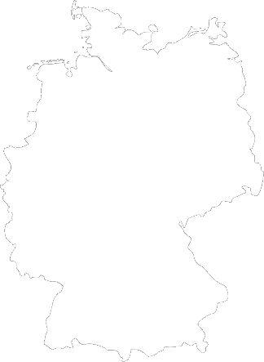























Reimbursements in the past years
2001
2006
2001
Bremer- haven
Berlin
2008
2002
Düsseldorf
Dresden
2008
2002
Frankfurt
2010
2003
Bad Mergentheim
Singen

Slide 9

Reimbursement
Depositors
Amount of Deposits
800
8.200 Mio. $
12.000
160 Mio. $
1.900
24 Mio. $
57.000
93 Mio. $

Slide 10
Different types of banks
big
small
Size
self produced
standard
IT-System
structured
Product
plain vanilla
international
local
Branches
institutional
customer
privat

Slide 11








Reimbursement of depositors since 2011
Period for delivering the data file
No claim of compensation
Compensation of incoming registrations within 20 business days from determination of compensation event
Compensation of incoming registrations within 20 business days from date of receipt

Slide 12




Reimbursement of depositors since 2011
Observating external interfaces
Checking and establishing the consistency of bank data
Ordering of interest accrual on a daily basis
Monitoring IT including infrastructure
Personnel Administration
Announcing the compensation event
Analysing and preparing bank data
Creating and posting the forms to submit claims
Calculating and disbursing the compensation claims
Reporting (internal / external)

Slide 13


EAEG-Einreicherdatei
Various forms of data input / Data output
Data integrity
Analysis of large data sets
Specific data-analysis functions
Skripts
MS Access based user interface
Using VBA-Scripting for program logic
SQL database
Modular design

Slide 14



ACL / InvComp
Internal accounting data
Insolvent institut
Compensation data InvComp
Data preprocessing
Check lists for manual verification
EAEG presenter data file
Ongoing monitoring of claim forms
Capture to document stacks
Data preprocessing InvComp
ACL
Compensation data
Creatig file for internal acc. data
Letters for customer
Creating file for payment system (SEPA)
Info. Sheet / Form to submit claim
Various reports
SEPA Credit Transfer
Third institut
InvComp

Slide 15


Reimbursement of depositors since 2011
Deposit Guarantee and Investor Compensation Act (EAEG)
"… the institution shall make the documents necessary for the creditors’ compensation available to the compensation scheme promptly, and at the latest within one week."
"The compensation scheme shall meet duly examined claims […] no later than 20 working days".

Slide 16

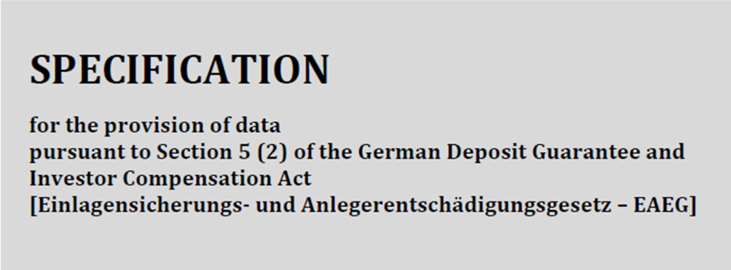




EAEG presenter data file
Version 3.0
Data file content
Data file format
Unique key values
German Regulation on the Accounting of Credit Institutions and Financial Institutions (Verordnung über die Rechnungslegung der Kreditinstitute und Finanzdienstleistungsinstitute – RechKredV)
Storage type Text file with field delimiters
Numerous Unification for certain key values:
Character set In accordance with DIN 66003:1999-02
“liabilities to customers” [liability item 2] in Section 21
Field delimiter * ("Asterisk" – ASCII Hexcode X'2A')
Range of values for "Exclusion indicator"
In addition:
End-of-record characters CRLF ["Carriage Return" (ASCII Hexcode X'0D'), followed by "Line Feed" (ASCII Hexcode X'0A')]
Range of values for "EdB key" data field
“contingent liabilities” (liability item 1 under the line) in Section 26
“claims on customers” (asset item 4) defined in Section 15

Slide 17







EAEG presenter data file
Version 3.0

Slide 18


EAEG presenter data file
Field no. | Field | Type | Explanation
A1 | Record identifier | 1A | Constant "A"
A2 | Presenter | 4A | Identification of presenting institution. Constant in accordance with value table in Appendix 2
Field no. | Field | Type | Explanation
B1 | Record identifier | 1A | Constant "B"
B2 | Sequence number | 40A | Number identifying customer (natural or legal persons).
B3 | Last name | 150A | Last name of customer. Where legal persons or groups of persons are involved, corresponding designation pursuant to Section 154 German Fiscal Code (Abgabenordnung – AO).
B4 | First name | 100A | First name of customer.
B5 | Name affix | 100A | Any other information additionally identifying customer.
B6 | Title | 1N | Title key in accordance with Annex 3.
B7 | Street and house number | 100A | Street and house number, plus – if applicable – post office box, where customer can be reached by post.
B8 | Street affix | 100A | Other pertinent information, particularly for correct postal delivery, e.g. name of district, apartment number, etc.
B9 | Postcode | 10A | Postcode
B10 | Place | 100A | Customer’s place of residence.
B11 | Country | 2A | Indication of country key in accordance with coding list ISO-3166-1-alpha2.
B12 | Date of birth | 8N | Date of birth or date of incorporation: DDMMYYYY.
B13 | Industry/sector | 3A | Values in accordance with Deutsche Bundesbank "Banking statistics guidelines and customer classification".

Slide 19

EAEG presenter data file
Field no. | Field | Type | Explanation
C1 | Record identifier | 1A | Constant "C"
C2 | Account number | 40A
C3 | Additional account designation | 50A | Where available, other information specifying intended use of account (e.g. joint account, rent account, escrow account)
C4 | Beneficial owner | 100A | First name, last name and date of birth/incorporation of person(s) for whom business relationship was established from an economic perspective. For rent deposit(s) invested by a landlord, corresponding details of tenant(s).
C5 | Number of account holders | 2N | Necessary to correctly split up deposits held in joint accounts.
C6 | Opening of account | 8N | Date when account was opened: DDMMYYYY.
C7 | Type of account | 20A | Documentation of product (current account, time deposit account, etc.).
C8 | Currency | 3A | Entry of currency key in accordance with ISO-4217 code table.
C9 | Capital balance in currency | 20.2N | Where debit balance is displayed, "-" (minus) sign should be placed in front of amount.
C10 | Conversion rate | 5.5N | ECB reference rate published on cutoff date; for euro deposits, value "1.0".
C11 | Capital balance in EUR | 20.2N | Where debit balance is displayed, "-" (minus) sign should be placed in front of amount.
C12 | Interest rate | 5.5N | Percentage interest rate on credit balance applying on cutoff date. For products with a sliding rate of interest, this field should be filled in with the figure “9” (99999.99999"). For current accounts, interest rate paid on credit balance should be applied. For asset accounts, provision of an interest rate is not required.
C13 | Last payment of interest | 8N | Date of last payment of interest on deposit accounts: DDMMYYYY.
C14 | Next payment of interest | 8N | Date of next payment of interest on deposit accounts: DDMMYYYY.
C15 | Final maturity | 8N | Date of repayment of deposit: DDMMYYYY.
C16 | Interest calculation method | 1N | Method used to calculate interest in accordance with key table in Annex 4.
C17 | Interest balance in account currency | 20.2N | Interest balance on deposit accounts on cut-off date set by EdB. This cut-off date may be any working day of a month.
C18 | Interest balance in EUR | 20.2N | Interest balance on deposit accounts on cutoff date set by EdB. This cut-off date may be any working day of a month.
C19 | Account balance | 20.2N | Sum of capital balance in EUR (field C11) and interest balance in EUR (field C18). Debit balances should be indicated with a "-" (minus) sign.
C20 | Exclusion indicator | 2N | Indicator which, under the EAEG, excludes account or customer from compensation. Values that may have to be used are defined in Annex 5. Where more than one value is applicable, lowest value should be entered.
C21 | EdB key | 2N | Blocking notice entered on institution side, which should be coded in accordance with Annex 6.
Notes:
……

Slide 20


EAEG presenter data file
Field no. | Field | Type | Explanation
D1 | Record identifier | 1A | Constant "D"
D2 | Sequence number | 40A | Number identifying customer (natural or legal person, group of persons, etc.)
D3 | Aggregate customer balance | 20.2N | Sum of account balances in data field C19 | Excluding account balances with values "09" or "10" in data field C21.
D4 | Aggregate balance Exclusion | 20.2N | Sum of account balances for accounts with value entry in data field C20
D5 | Compensation balance Customer | 20.2N | Data field D3 ./. data field D4; data field D5 should contain value "0.00" if result is negative and value "100,000.00" if result exceeds EUR 100,000. Amount in excess of EUR 100,000 should be entered in data field D6.
D6 | Aggregate balance Capping | 20.2N | Amount exceeding “100,000.00" from data field D5.
D7 | Balance not eligible for compensation | 20.2N | Data field D4 + data field D6
Field no. | Field | Type | Explanation
E1 | Record identifier | 1A | Constant "E"
E2 | Presenter | 4A | Identification of presenting institution. Constant in accordance with value table in Annex 2.
E3 | Aggregate presenter balance | 20.2N | Sum of values from data field D3
E4 | Aggregate presenter balance Exclusion | 20.2N | Sum of values from data field D4
E5 | Aggregate presenter balance Compensation | 20.2N | Sum of values from data field D5
E6 | Aggregate presenter balance Capping | 20,2N | Sum of values from data field D6
E7 | Aggregate presenter balance not eligible for compensation | 20,2N | Sum of values from data field D7

Slide 21
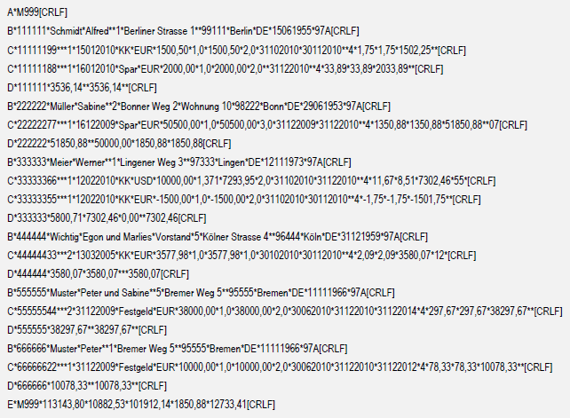
EAEG presenter data file
Version 3.0

Slide 22

Outlook for future
Realisation and/or support by
Version 3.0
Proposal for a directive on Guarantee Schemes
COM(2010) 369 / July 2010
Reducing the payout deadline from twenty to seven days
Provision of information about eligible and covered deposits at any time after request of DGS
Tagging of all non-repayable deposits in system
Possibly benefits when calculating contributions for DGS

Slide 23
Implementation of the EAEG presenter data file
Information
Support
Audit

Slide 24


Information
Member banks were informed by German Private Commercial Banks Compensation Scheme for Investors (EdB)
Liability to create EAEG presenter data file
Audits of correctness advised

Slide 25



Support
Support via email
Test
data files
spezifikation@einleger- entschaedigung.de
Review

Slide 26

Experiences & Auditprocess
Review concerning test date files
Highlights in % regarding total number of files
Database (incl. accrued interest)
85%
Joint accounts / SCV
43%
Marking / Tagging
35%
Technical correctness
(length, form, type of datafields)
32%
Debitors
28%
Others
43%

Slide 27
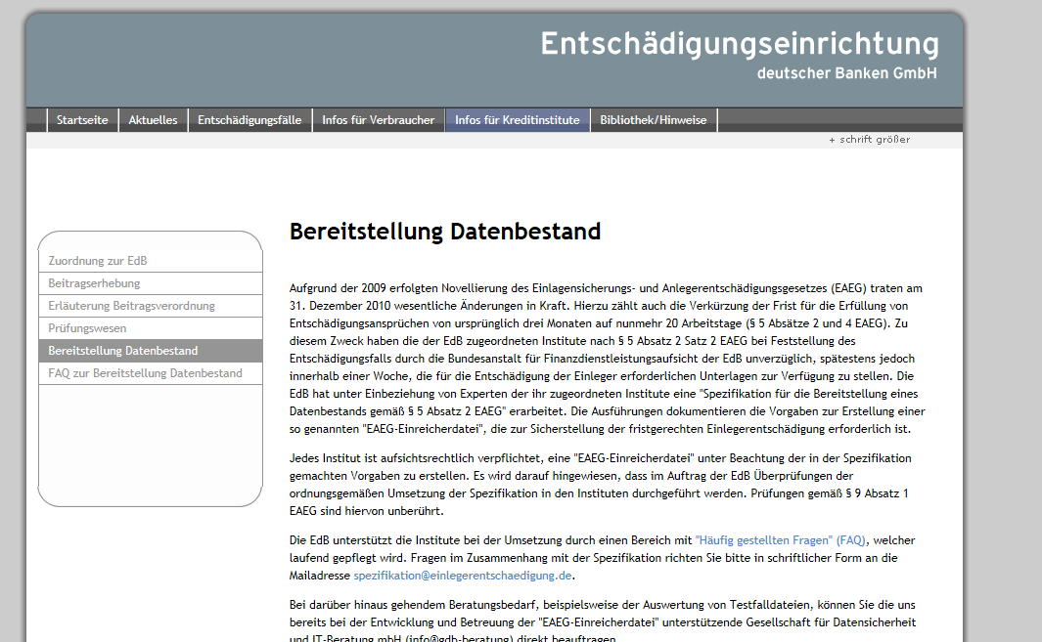
Support

Slide 28
Auditing-Goals
Section 5 (2) EAEG:
EAEG presenter data file
has to be delivered by
bank within one week
Section 5 (4) EAEG:
Content of delivered
EAEG presenter data file
has quality to reimburse within 20 days

Slide 29

Auditing Frameworks
Section 9 (1) of Deposit Guarantee and Investor Compensation Act (EAEG)
“The compensation scheme shall perform regular and ad hoc audits of the institutions assigned to it in order to assess the risk of a compensation event occurring.”

Slide 30
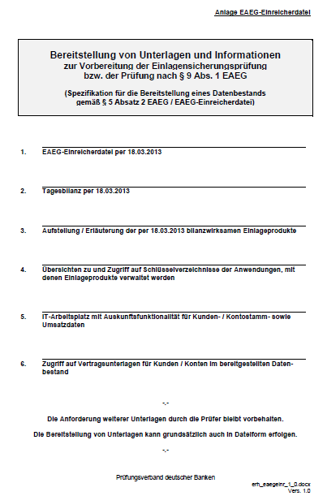

Request to bank for making available specific
data and documents
For example
auditing at:
A-Bank
EAEG presenter data file D-Day 18th March
Daily balances also per 18th March 2013
Illustration of all deposit product types
A-Bank has per D-Day 18th March 2013
Overview about and granted access to all blockage codes A-Bank has in his main IT-application, using to admin deposit products
IT-desk during auditing incl. right to get informations about clients, accounts and transactions
Access to customer contract documents
for relevant clients

Slide 31
Data base
Building data base of
EAEG presenter data file
Liability against customers
Loans against customers
Contingent liabilty
EAEG presenter data file
Non-eligible
eligible
covered
Missing data of clients and/or clients-balances
in case of wrong-builded data base

Slide 32
Data base
Building data base of
EAEG presenter data file
System 1
System 2
Liability against customers
Liability against customers
Loans against customers
Contingent liabilty
Loans against customers
Contingent liabilty
EAEGpresenter data file
EAEG-Einreicherdatei 1
Non-eligible
eligible
EAEG-Einreicherdatei 2
covered

Slide 33


Data base
Building data base of
EAEG presenter data file
Example
Client K.
System 1
System 2
70.000 Euro
40.000 Euro
Compensation
110.000 Euro
EAEG presenter data file1
Non-eligible
eligible
EAEG presenter data file 2
covered
nicht entschädi-gungsfähig
eligible
covered

Slide 34

Data base / accrued interest
Building data base of
EAEG presenter data file
Accrued interest
§ 5 (1) EAEG
18.03.
Compensation event
31.12.
30.03.
31.12.
Product-types
Current account
Savings
Fixed-term
deposit
Accrued interest

Slide 35

Data base / data form
Data form (technical)
Incorrect individual- and aggregate balances
Marking of debit- and credit balances
Thousands separator
1.000,00
1,000.00
Compliance of information obligation delayed or missing § 5 (2) EAEG
Data field-length:
Mainstrasse 14

Slide 36
Data base / debit balances
Depositors with debit balances
Missing consideration
Data base bank
Client | Acc. | Balance | Aggregate
11111 | 10 | 5.000,00
 | 11 | 200,00
 | 12 | -100,00
11111 |  |  | 5.100,00
Missing consideration
Consideration clients only with debit balances
EAEG presenter data file
Client | Acc. | Balance | Aggregate
11111 | 10 | 5.000,00
 | 11 | 200,00
11111 |  |  | 5.200,00
Accrued interest for debit and credit balances

Slide 37
Data base / debit balances
Depositors with debit balances
Consideration clients only with
debit balances
Data base bank / EAEG presenter date file
Missing consideration
Client | Acc. | Balance | Aggregate
22222 | 20 | 150,00
 | 21 | -20,00
22222 |  |  | 130,00
33333 | 30 | -100,00
33333 |  |  | -100,00
Aggregate |  |  | 30,00
Consideration clients only with debit balances
Accrued interest for debit and credit balances

Slide 38
Data base / debit balances
Depositors with debit balances
Accrued interest for debit
and credit balances
Data base bank / EAEG presenter date file
Client | Acc. | Balance | Aggregate
22222 | 20 | 150,00
 |  | (Interest) 10,00
22222 |  |  | 160,00
33333 | 30 | 500,00
 |  | (Interest) 30,00
 | 31 | -100,00
 |  | (Interest) -20,00
33333 |  |  | 410,00
Aggragate |  |  | 570,00
Missing consideration
Consideration clients only with debit balances
Accrued interest for debit and credit balances

Slide 39
Audit Background
Organisational basics
Programming order-, test-, release- and livegoing-proceedure
Definition of functional responsibility
Method description

Slide 40
Further necessary checks
Further data has to be check:
Level of coverage
Consistence of client data (name, adress, date of birth…)
Consistence of account data (number account holders, due date..)
…
Notes:
….

Slide 41



Audit-report
EAEG presenter data file was delivered within the law (one week)
Content is convenient to reimburse in 20 days
Audit-report by
Federal Financial Supervisory Authority (BaFin)
Addressed
audience
EdB

Slide 42
Olaf Hartenfels Fon: +49-221-91 26 97-412 Fax: +49-221-91 26 97-470
o.hartenfels@eis-treuhand.de
Thank you!

