Slide 1
Solutions to address poor data quality DIA, Russian Federation
RUSSIA
Alexander Chumaev
Deputy director, DI Dept

Slide 2
Outline of presentation
1. DIS mandate and general statistics of operations
2. Roots of poor data quality and challenges for payouts
3. Outline of solutions to increase data quality
4. Detection of insurance fraud caused by data manipulation

Slide 3
1. DIS mandate and general statistics of operation

Slide 4
DIS mandate
December 2003 (inception of DIA)– DIS Law – paybox for bank depositors
August 2004 – Bank Insolvency Law - bank liquidation mandate
October 2008 – Bank Rehabilitation Law - open bank assistance mandate to prevent bank bankruptcy
2013 – Accumulated Pensions Guaranty Law (to be passed) – paybox for private pension funds

Slide 5
Paybox in figures (November, 2013)
DIS member banks – 762 (+ 106 under liquidation)
Total amount of insured deposits – RUR 15,3 trln
Deposit insurance fund – RUR 220 bn (US$6,7 bn)
Covered products - current and saving accounts of natural persons in any currency
Insurance coverage level - RUR 700000 (US$21900) per depositor per bank
Number of insurance events with payouts – 151
(21 in 2013, 4 in November )
Number of reimbursed depositors – 520 th
Volumes of reimbursement – RUR 104 bn
Largest insurance cases –
20.11.2013 (RUR 31 bn, 200 th depositors*)
30.09.2013 (RUR 20 bn, 50 th depositors*)
* With total balance over RUR 1000

Slide 6
Insurance cases and payout volumes, 2005-2013

Slide 7
Insured deposits and potential DIA liability

Slide 8
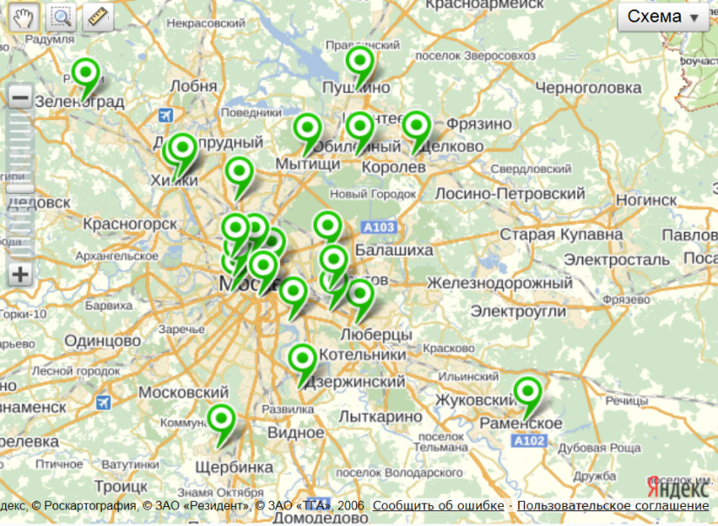
Example of payout geography (insurance event 10/09/2013 - EIB Bank, 17 branch offices, 4500 depositors, RUR 1,7 bn in deposit liabilities)
Moscow
Ekaterinburg
Moscow
Samara
39 payout locations

Slide 9
Legal framework for payouts
Insurance case is triggered by banking license revocation
DIA is invited (in fact 1-2 days before triggering event) to include its representatives in interim bank administration, set by supervisor
Depositor’s Register in standard form as legal grounds for payout to be provided by the bank’s temporary administration within 7 days
7 more days for DIA to set up and advertise payouts
Reliance on failed bank’s records with aggregated liabilities, counter claims and reimbursement amounts (“virtual” set-off is applied)
Individual depositor application for reimbursement (in writing) is mandatory, no proof of claim is needed, application period is limited by bankruptcy termination
Mandatory means of payout: cash (money over the counter or postal transfer) or bank transfer to clients’ account in another bank (as indicated in application)
3 business days for DIA to settle individual application
DIA has an option to appoint paying agents among DIS member banks to process claims and make payouts

Slide 10
Other DIS functions in figures
114 ongoing bank liquidation processes with 71 th general creditors and RUR 304 bn in claims
Total record of 309 bank liquidations in 2004-2013 including 194 processes finished
Total record of 19 financial rehabilitation cases in 2008-2013 including 14 completed (RUR 180 bn in insured depositor liabilities)

Slide 11
2. Roots of poor data quality and challenges for payouts

Slide 12
Natural order of the Caucasus…

Slide 13
Local bankers’ copy …

Slide 14
Roots of poor data quality
“All happy families resemble one another, but each unhappy family is unhappy in it’s own way”
Lack of external/internal regulation/control
Isolated databases for different retail products
New software installation (data migration faults)
Historical incompleteness of records (sleeping accounts)
Tellers misprints in client identification fields and careless clients (never read papers)
Intended data manipulation/forgery in records
Lack of aggregation (multiple client’s IDs, changes in family name, no unique national identifier)
Technical reasons (hardware/power supply faults)
Etc, etc…

Slide 15
Impediments to payout process
Payout schedule is under risk
Client identification risk
payout to wrong person
denial of payment to rightful depositor
full-scale claim proof instead of formal application
Risk of miscalculation of reimbursement amounts
caused by:
violation of SCV principle - duplication of clients and/or other distortion of relations between customer and its deposit/loan accounts;
inadequate accounting incl. miscalculation of accrued interest;
etc.
Client written notification of payout is impossible
caused by address data incompleteness/faults
Public confidence in DI is under threat

Slide 16
3. Outline of solutions to increase data quality
Regulatory framework
IT & software solutions
Regular bank examinations
Effective task force on insurance case
Fraud investigation and “splitters” claims management

Slide 17
Regulatory framework
Legal requirement for unified SCV structure of depositor data (depositor register) to be presented by DIS member on request within 7-days
Legal right for DI staff to participate in on-site examinations under CBR supervision
Regulatory requirement to safe keep databases and to deposit a backup copy with CBR on demand
Internal regulation for CBR to request SCV from troubled bank when its deposit-taking operations are suspended
DIA-CBR assistance agreement to report any potential risk in depositors data

Slide 18
Unified SCV data structure*
File name | File contents and structure
BANK (bnk.txt) | Bank data: title and license number
BRANCHES (fil.txt) | Branches data: title, number and address of each retail branch
CLIENTS (inv.txt) | Customer data: ID, name, passport details, permanent and mailing addresses, e-mail
DEPOSITS (dep.txt) | Deposit accounts data: ID of the accountholder, bank branch number, account agreement code; date of opening, account number including currency code, balance of account in original currency
LOANS (crd.txt) | Loan (credit) accounts data: same structure as for deposits
CONTROL (ctr.txt) | Key totals for register integrity control: total number of customers, accounts and total balances for deposits and loans in each currency
* CBR Regulation issued in 2004

Slide 19
SCV files sample

Slide 20
SCV standard benefits for payout process
No need to have individual interface to upload depositor data for each of 790 operating member institution
No urgency for DI to have access to bank records on the eve of triggering event
Unified time limit requirement (7 days) for deposit register compilation allows DI to comply with targeted payout launch delay
Mandatory set-off and reimbursement calculation is automatic due to consolidated deposit and liabilities accounts
Standard data format is an effective way to improve data validation means and software
Easy way to pass the depositor data to payout agent banks
т
8

Slide 21
IT & software solutions
Free validation software for bank self-tests of depositor register data quality
Integrated payout software used by DI in insurance cases
Software for filtering suspicious transactions and insurance fraud investigation as part of data cleansing on insurance event
Basic CRM functionality implemented in software to analyze suspicious transactions data and process numerous complaints within time frames

Slide 22
Depositors data validation software
For member institutions
Batch mode version (CHECK) – primer application produces delimited text reports for further download
Interactive mode version (ANALYSIS) – user friendly multifunction database application
For DI
Payout integrated software (INSURANCE&LIQUIDATION PAYOUTS) – includes analysis functions

Slide 23
Basic SCV validation objectives
Search in SCV for formal data errors, omissions, inconsistency
Reconciliation of account balances with the ledger
Backward evaluation of record keeping techniques
Calculation of reimbursement
Identification of risks for the insurer in case of payout
Insurance fraud recognition

Slide 24
Basic SVC validation techniques
Data integrity verification
Strict format and completeness control
Cross-field multiplication search
Control of full account-per-depositor aggregation (SCV principle)
Heuristic recognition and parsing of address fields + correction hints
Statistic analysis (breakdown of accounts and depositors per various groups)

Slide 25
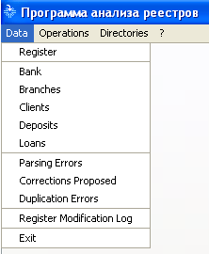
ANALYSIS software: DATA menu

Slide 26
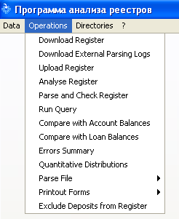
ANALYSIS software: OPERATIONS menu

Slide 27
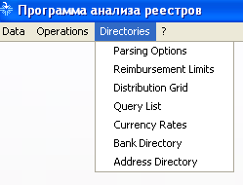
ANALYSIS software: DIRECTORIES menu

Slide 28
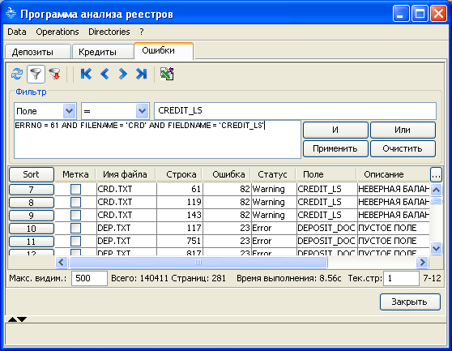
ANALYSIS software: filtering parsing errors

Slide 29
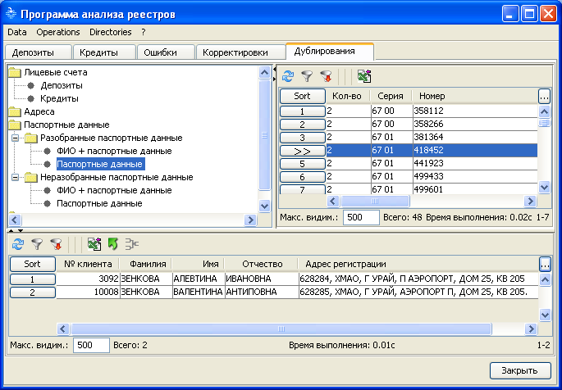
ANALYSIS software: DUPLICATION errors

Slide 30
Regular bank examinations
On-site examinations set up jointly by supervisor and insurer (75-100 banks annually, 5 years on average between exams for non-troubled banks)
Off-site review of results of SCV self-test performed on demand of supervisor (10-20 tests per month)
Complex rating of member bank compliance to DI requirements (incl. SCV rules)

Slide 31
Effective task force on insurance case
Typical task force for insurance case management
On-site:
Task manager in charge (1)
Depositor data processing expert (1)
IT support/bank automation system expert (1)
Insurance fraud evaluation expert (1)
Security (1-2, optional)
Client documentation revision (1-3, optional)
Off-site:
Case manager (communication with agent bank)
Complaints processing (1-2)
Feasible limit for DIA managing concurrent insurance cases – 5-7 (totally number of staff in DI Division – 35)
(3 license withdrawals a week is a record for Regulator)

Slide 32
4. Detection of insurance fraud caused by data manipulation

Slide 33
Fraud in Deposit Insurance (IADI survey statistics, 25 DIS)
80% of respondents indicated that their jurisdictions have laws or regulations facilitating the prevention and/or prosecuting fraud in deposit insurance
Only 3 respondents (12%) indicated that fraud has been a historical problem or concern
Only 3 respondents (12%) are responsible for investigating DI frauds

Slide 34
Main types of deposit insurance fraud
Attempts to get sums above coverage limits by splitting deposits with excess amounts between other beneficiaries just before the bank license revocation
Camouflaging non-insured funds (of legal entities, private entrepreneurs) as insured deposits
Creating purely artificial deposits (savings “out of the blue”)

Slide 35
Statistics of insurance fraud cases
more than 7 bln RUR
4.8 bln RUR

Slide 36
New tricks in DI fraud
Heavy advertising of high yield deposit products on the eve of expected failure
Cashier transactions imitation instead of traceable bank transfers
Fake bank robbery to cover cashier’s deficit
Fake bank staff bonuses transferred to their insured accounts
Fake redemption of clients’ loans
Deposits recorded in past business days (behindhand)
Deposits opened by proxy
Dummy accounts opened beforehand
Mess in client documentation to prevent reconciliation
Numerous and diversified fraud methods used simultaneously

Slide 37
Some tips to identify fraudulent operations and prevent illegal payouts
create and permanently refine methods and tools along with formal criteria
find proof whether and when the bank was low on liquidity before the license revocation
identify decrease in volume of large deposits and increase in number of fresh deposits with balance close to coverage limit
verify exact timing of operations: most shady transactions are registered in non-business hours, use time-study and signal processing techniques
cooperate with interim administration to timely exclude shady operations from payout register
cooperate with law enforcement agencies to get extra evidence from persons involved
apply for court order to suspend payouts on suspicious deposits

Slide 38
Time-study of suspicious deposit data
10 deposits in 15 minutes

Slide 39
Lessons learned: further steps to prevent insurance fraud
DIA needs additional legal powers to effectively prevent and prosecute deposit insurance fraud:
to qualify suspicious operations as illegal on clear and solid grounds based on banking regulation;
to suspend payouts on suspicious deposits outside the time frame of standard payout schedule;
to legally reject payouts to depositors whose claims emerged from fraudulent transaction;
to receive on insurance event not only balances of depositor accounts in SCV form for payout calculations, but also a consolidated ledger of all clients operations registered within 6 months prior to insurance case in a unified format.

Slide 40
Thanks for your attention!
Visit www.asv.org.ru
for more details
RUSSIA

